Slide 1
Enforced Disappearance: The Case of Sombath Somphone
Shui Meng Ng
Castan Centre 6 March 2014

Slide 2
Sombath: The Man and his Work
Child of the Soil
Eldest son of a poor farming family

Slide 3
Early Days
Grew up poor & experienced war
Understood poverty and challenges of rural life; but also appreciated the joys of simple living & importance of nature
Experienced devastation of war – family refugeed in Thailand for a year to escape fighting
Early life influenced his later life – chose to study agronomy – but also reflected on appropriateness of modern agriculture in Lao context.

Slide 4
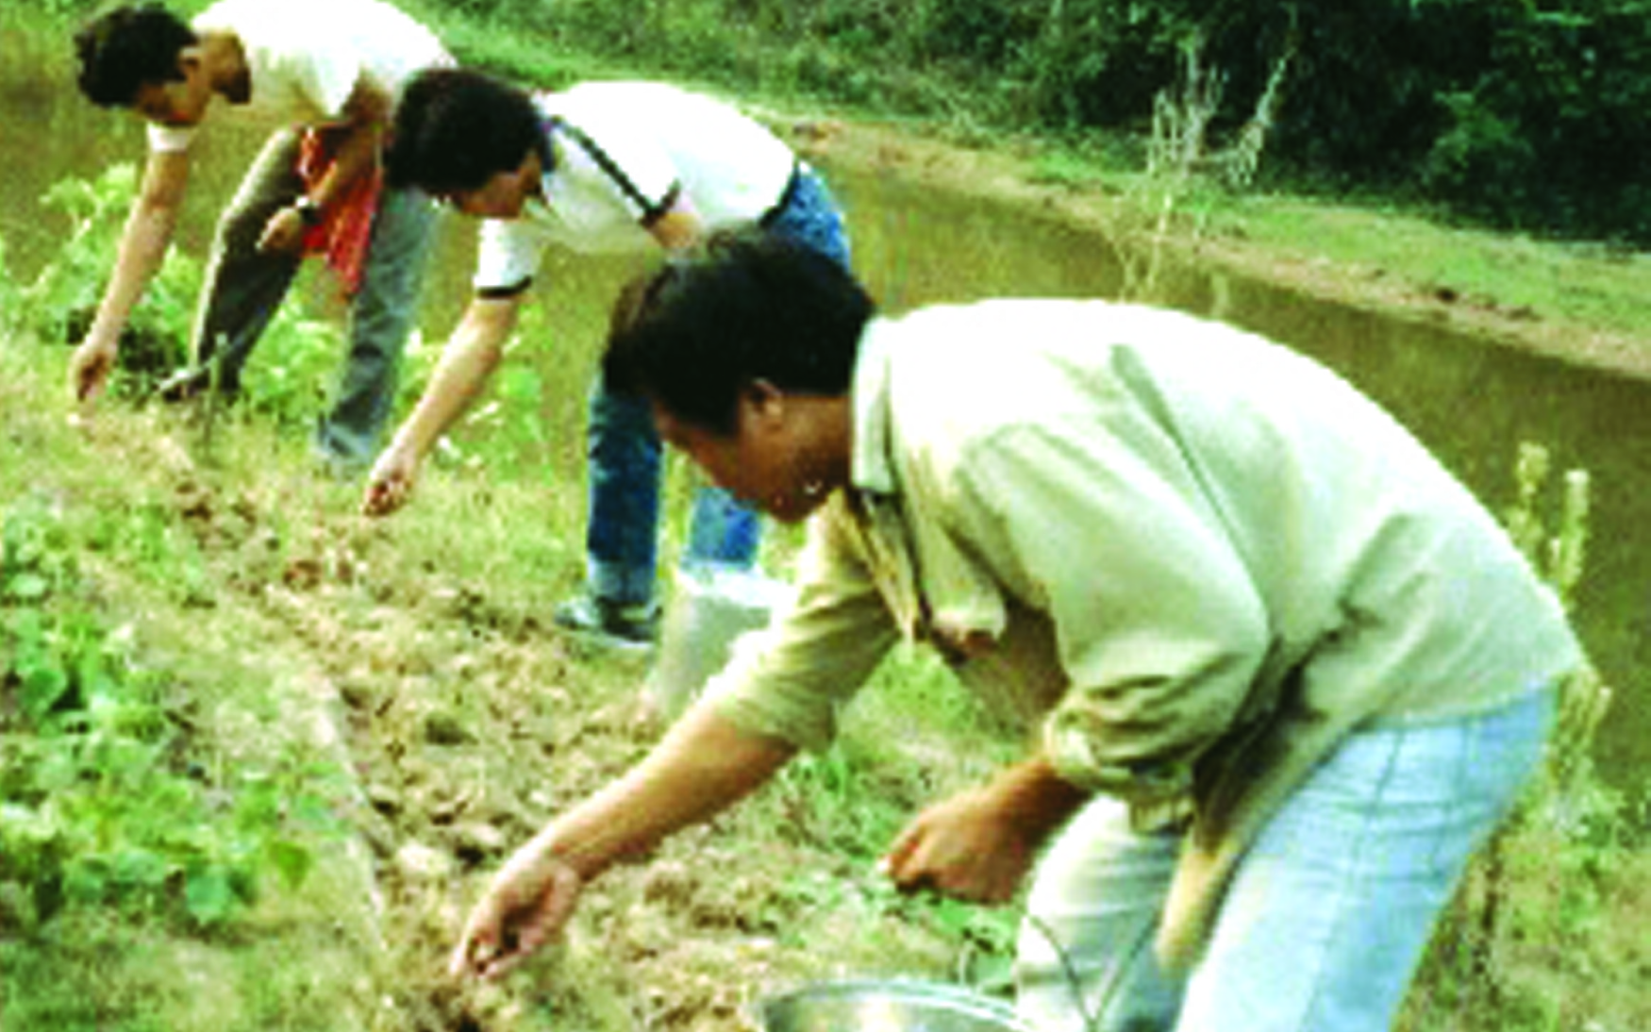
Respectful of indigenous knowledge and appropriate technologies
Field practice of appropriate technologies: alley cropping and “azola” a type of algae (green fertilizers)

Slide 5
Learning from Actual Practice
Strong respect of indigenous practices and knowledge
Experimented practices prior to introduction - making sure that these are culturally and technically relevant - avoided blind copying of practices.
Technologies introduced include: bio-fertilisers; alley cropping; use of bio-insecticide, Integrated rice & fish farming systems, etc.

Slide 6
Main Focus of Work
Work: 1978- Mid-80s: Agriculture development; integrated community development (PRA); community-based planning, etc.
Mid-80s – mid-90s: Shifted more and more towards education and youth development
Founded Participatory Development Training Center (PADETC) in 1996 under MoE Private Education Decree
Provided training for different target groups, but with main focus on training of farmers, teachers; monks, youth, and community groups – especially women.
Work areas in response to need as well as opportunities.

Slide 7
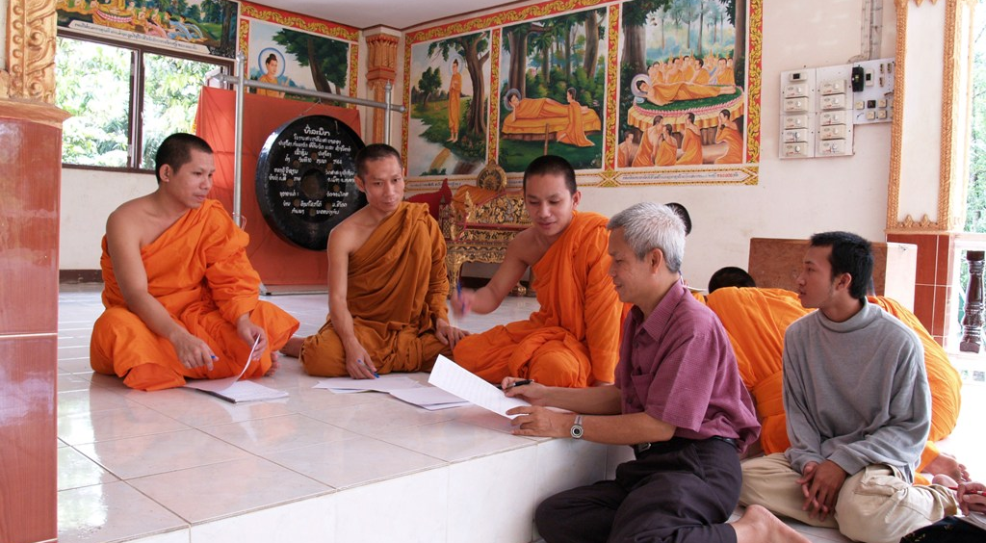
Major Influences

Slide 8
Major Influences
Quakers – pacificism, non-violence, & social justice
Engaged Buddhism – influenced by Ajarn Sulak, Thich Nhat Hanh, Dalai Lama
Bhutanese Model of Development – GNH versus GDP
Developed his vision of balanced development

Slide 9
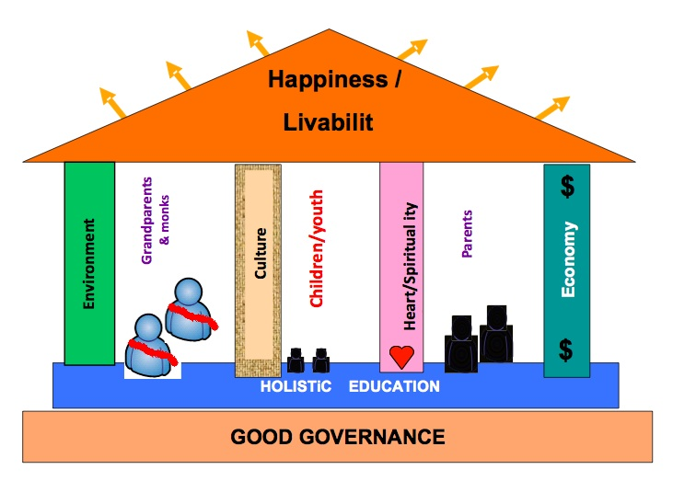
Balanced model of Development

Slide 10
Education of the Heart
Spirituality becomes his guiding principle in all his work
“Education of the Heart is the Heart of Education”
Increasing concerned that current model of development as being unsustainable – too much focus on greed and growth.
Using Buddhist terminology to explain development - “Happiness” versus “Suffering” and promotion of “holistic development”

Slide 11
The Abduction

Slide 12
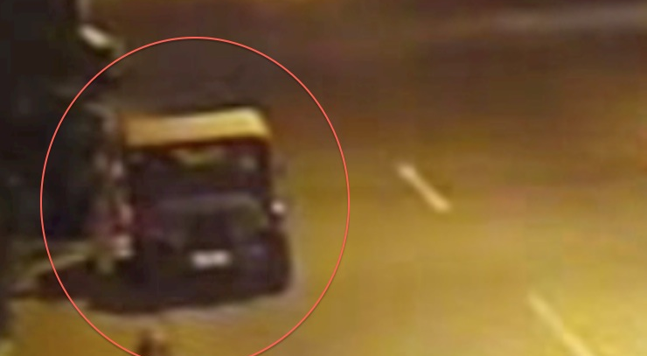
Sequence of photos from CCTV of Abduction
Police stopped Sombath’s Jeep

Slide 13
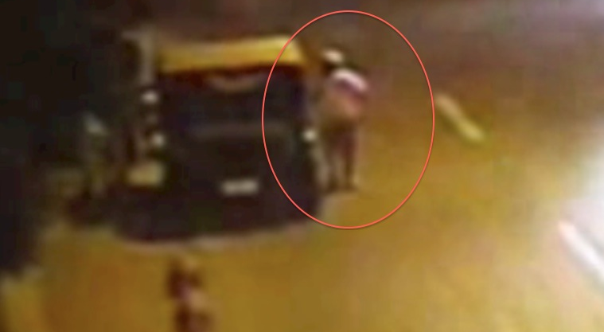
Sombath gets out of jeep

Slide 14
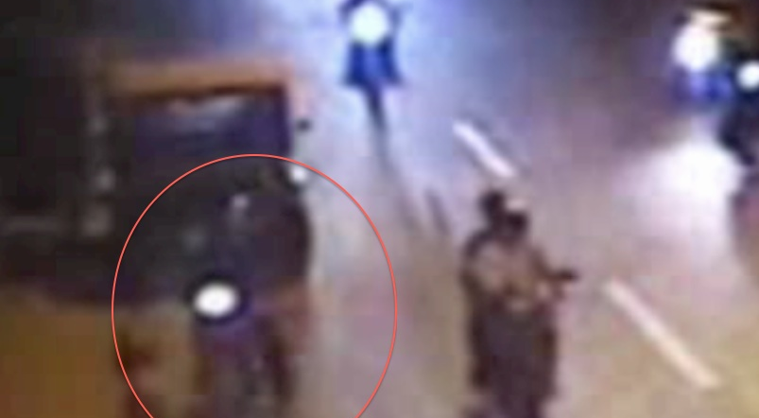
Motor cylist dressed came and stopped by jeep

Slide 15
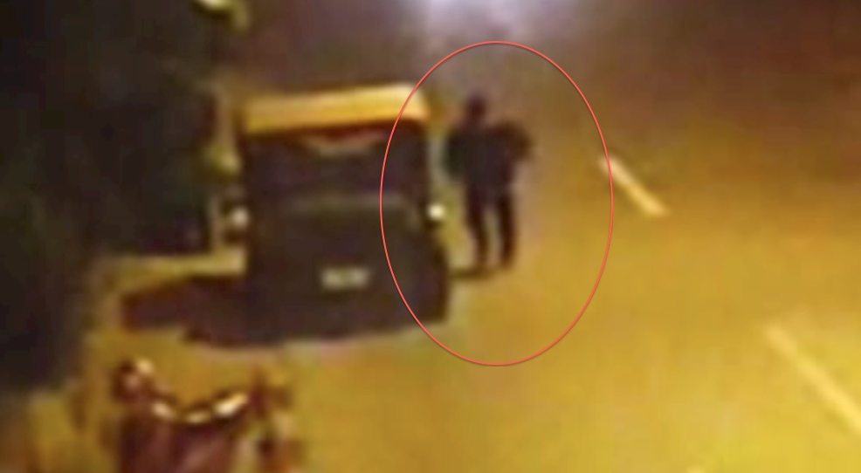
Motorcylist walked to police post

Slide 16
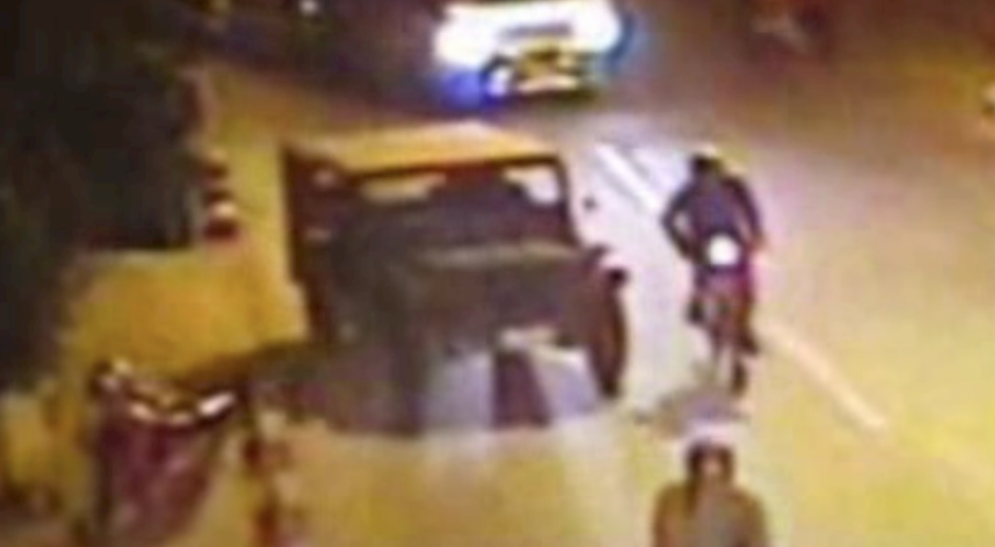
Motor cylist drove away Sombath’s jeep

Slide 17
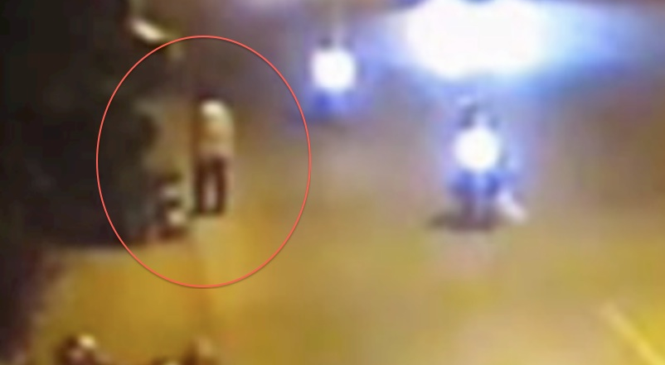
Policeman waiting by side of road near police post

Slide 18
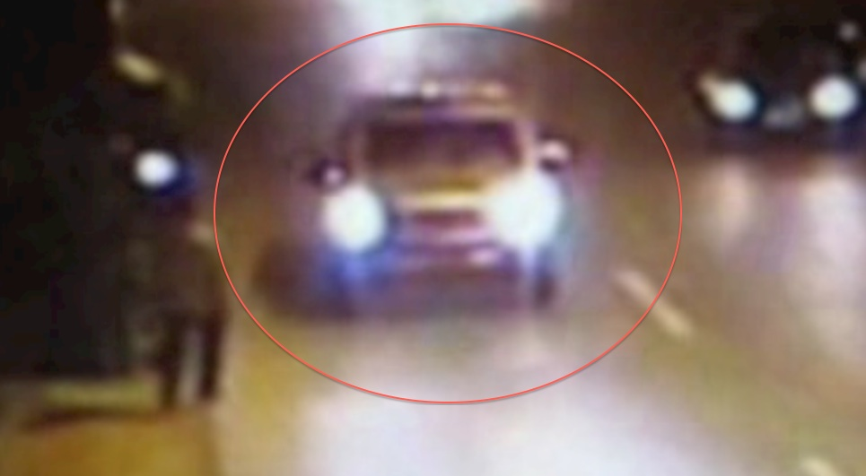
Whilte vehicle with flashing light stopped near police man

Slide 19

Sombath and 2 people got into white vehicle

Slide 20
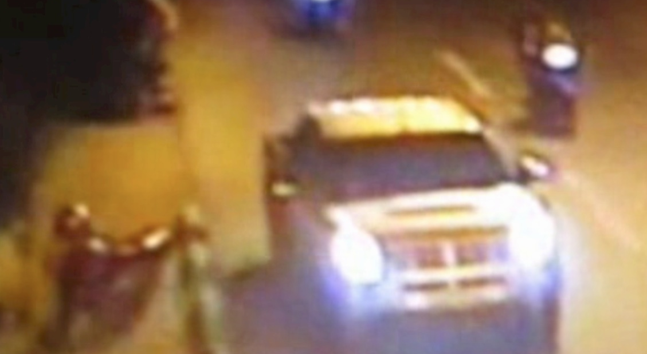
White vehicle driven away

Slide 21
Why the abduction, and why now?
Difficult to comprehend – style of work: consultative; consensus-building; non-confrontational – knew the context he worked in.
Worked with government partners at all levels
His work appreciated by people at all levels inside the country
Work also regionally and internationally recognized.

Slide 22
Could the AEPF be the trigger?
Asia-Europe People’s Forum – Sombath viewed the forum as opportunity to engage government and civil society in a dialogue on development issues and ideas
Nominated by NPAS and iNGOs to serve on National Organizing Committee (NOC)
Spear-headed community consultation in 17 provinces as means to “give voice to the people” – summary of consultation – integrated into final statement from AEPF.

Slide 23
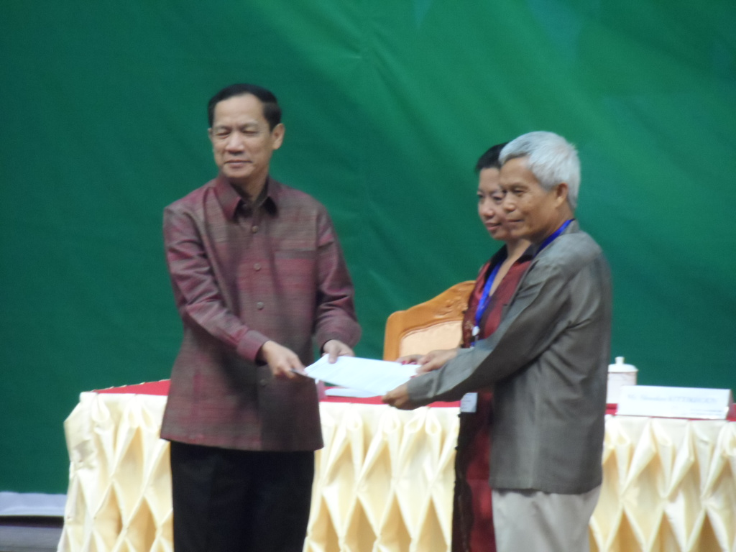
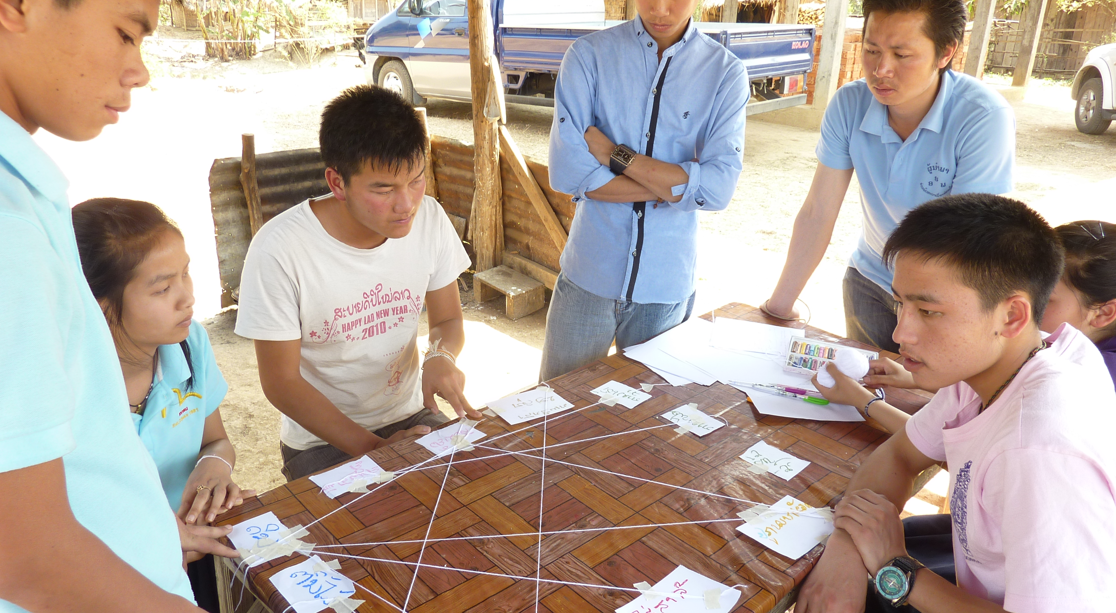
AEPF
Community Consultation Handing over Final AEPF Statement

Slide 24
Events during and after AEPF
Strong security presence at all sessions of AEPF
Final statement in English and Lao not allowed to be distributed - video made with support of EU not allowed to be shown or distributed.
Session on land and water issues very heated – Lao villagers threatened
Representative of Helvetas (Anne-Sophie Gindroz) expelled on 07 December 2012
Sombath abducted on 15 December 2012

Slide 25
Government statements and Global reaction to Sombath’s abduction
Government denies any involvement
An investigation team has been established and reportedly continues to investigate
Police statements: “could be kidnapped for personal or business conflict”
Global reaction continues to pressure Lao Government to provide credible answers around Sombath’s abduction
Sombath’s case is with UN Working Group on Enforced and Involuntary Disappearances (WGEID)

Slide 26
Reaction Inside Laos
Fear and silence prevails inside Laos; nothing is reported in the local media, except for official government statements/police reports.
Speculations and rumours inside the country – Sombath is not a Lao citizen; Sombath is a subversive working with foreign agents; absconded funds from the AEPF Forum and had to run away; etc. etc. etc.
Foreign press speculations – abducted for his activism against human rights abuses; organizing protests against the Sayaboury Dam; mounting protests by villagers against land grabbing etc.
ALL ABOVE SPECULATIONS ARE FALSE!!!

Slide 27
Enforced Disappearance & Human Rights
Enforced Disappearance - Mother of Human Rights violation
A person who is killed dies once; a person who is disappeared dies every day
Left to live in the agony of uncertainty - no closure for family – an endless wait

Slide 28
Laos and UN Convention Against Enforced Disappearance
Laos among one of the first signatories to the UN Convention Against Enforced Disappearance – but not yet ratified
Disappearances in Laos happens – but seldom reported; family members too afraid to disclose or discuss; afraid that other members of family will meet similar fate.
My own experience shows how difficult to get authorities/legal institutions to even acknowledge the case; lawyers, and courts do not want to touch such cases.

Slide 29
Sombath’s Disappearance and implications civil society
Work of civil society, especially at field level is reported to be more difficult since SB’s disappearance. Closer monitoring by local and central levels of work of civil society
Approvals for MOU and NPA registration – more difficult to obtain
New iNGO guidelines issued – presented but not yet adopted – appears to more restrictive
Fear and self-censorship by civil society actors, including iNGOs enhanced.

Slide 30
My Views
I still have no idea who could have ordered the abduction; but SB is a Lao citizen and the act was caught on camera – it is the responsibility of the state to investigate and solve the case.
External pressure is still needed to urge for serious and open investigation – cannot allow the case to be just swept away.
Lao people quietly watching – if nothing can be done for Sombath, nothing can be done for others.
I continue to hope that Sombath is still alive and that there are good people inside and outside government who care
I still hope he will come back – hopefully sooner than later.

Slide 31
The “Find Sombath” Campaign
The Find Sombath Campaign has to be sustained and continued – I look to your support.
For more information – visit the website: www.sombath.org established to sustain the “Find Sombath Campaign.
Continue to read and to share through social networks – Important that SB’s case will not be forgotten.

