Slide 1



LEARNING OUTCOMES
Learning Intention
Students will examine how language is used by different organisations to shape public perception of climate issues.
Success Criteria
Analyse and interpret persuasive language techniques used in real-world examples
Review and edit written statements to ensure clarity, coherence, and persuasive effect
Deliver a structured spoken statement using appropriate tone, formality, and multimodal elements for the intended audience
Notes:
Optional to show to students

Slide 2


'PRESSING' CLIMATE ISSUES:
Analysing persuasive language, ethics and credibility
Year 10 English
Notes:
USE THESE SLIDES ALONGSIDE THE LESSON PLAN

Slide 3
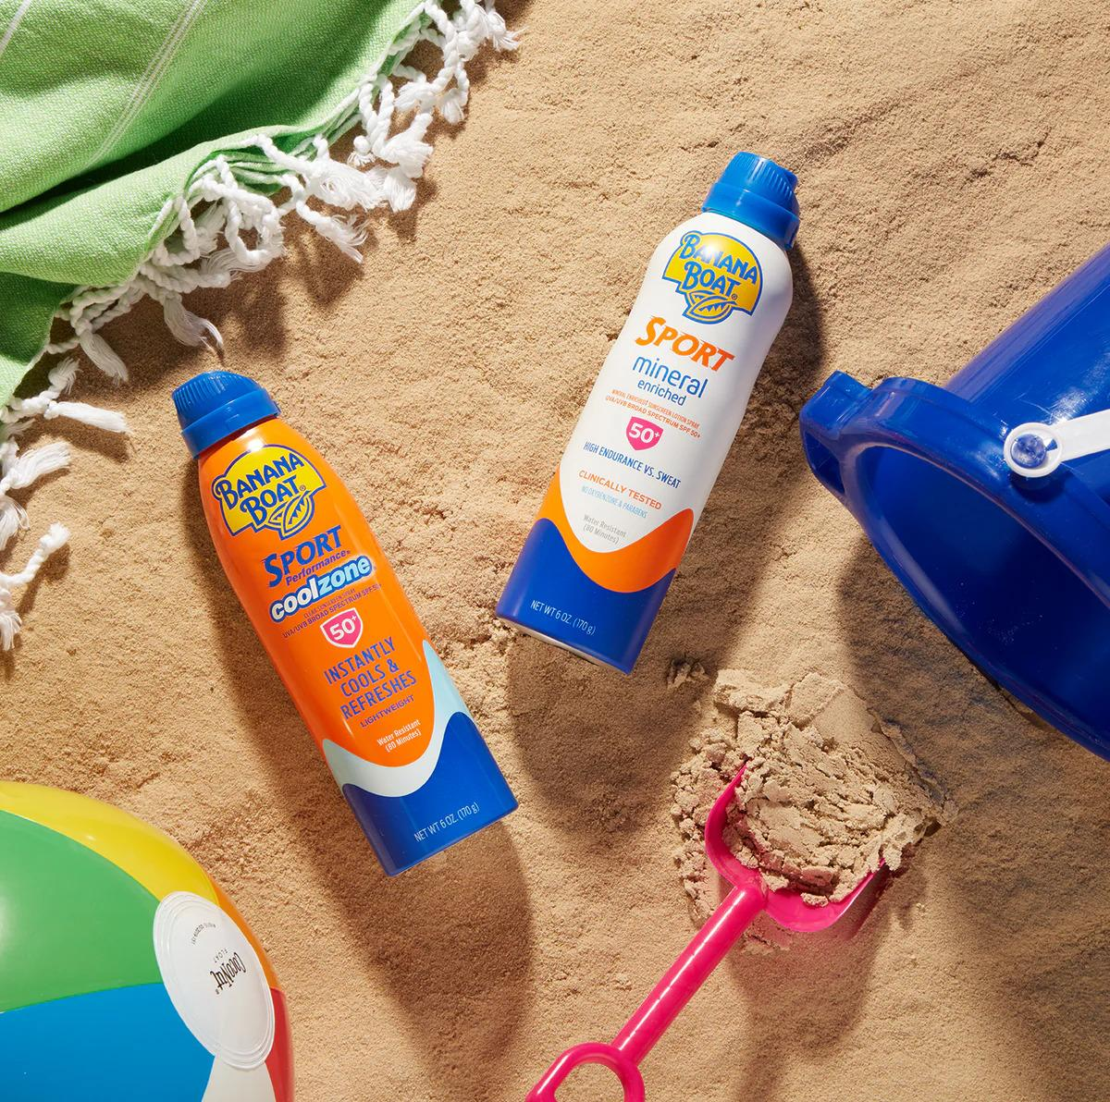


v
HAVE YOU USED BANANA BOAT SUNSCREEN?
Learning introduction
Notes:
SPEAKER NOTES:
Have students raise their hands yes/no

Slide 4
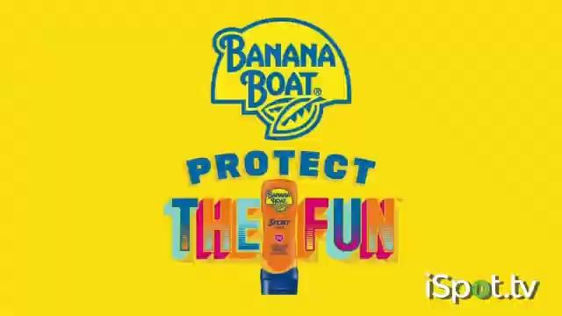
VIDEO: 'PROTECT THE FUN: REEF-FRIENDLY' AD
v
Learning introduction
Notes:
VIDEO: Banana Boat sunscreen, 'Protect the Fun: Reef-Friendly' – 15 seconds
Banana Boat promises its reef-friendly sunscreen is all about ‘protecting the fun, whether you're exploring the world or making a splash.’
Ad aired in 2021
The important part is the ‘reef safe’ claim for the following learning discussion.

Slide 5
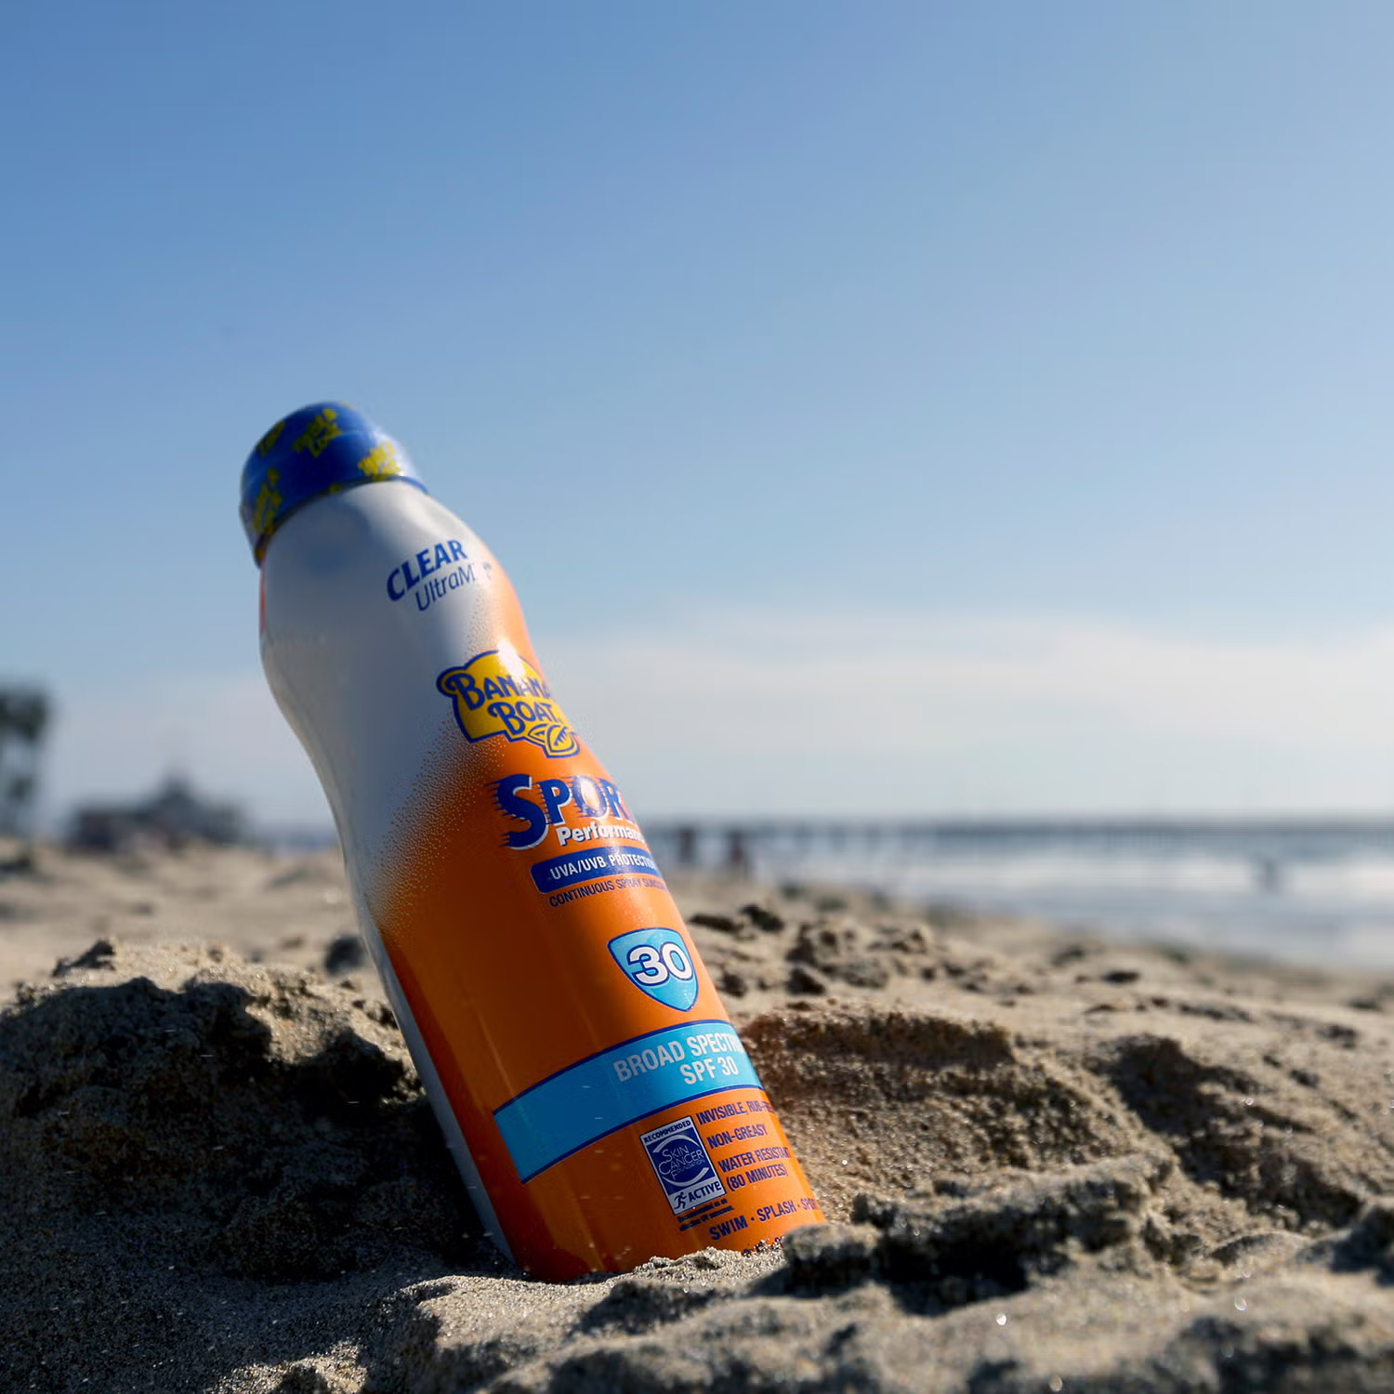
v
WHAT HAPPENED AFTER?
Learning introduction
Notes:
SPEAKER NOTES:
Ask if students know about any news from the brand (success or negative)
Some might be aware of the ‘sunscreen scandals’ and greenwashing that this is in reference to.

Slide 6
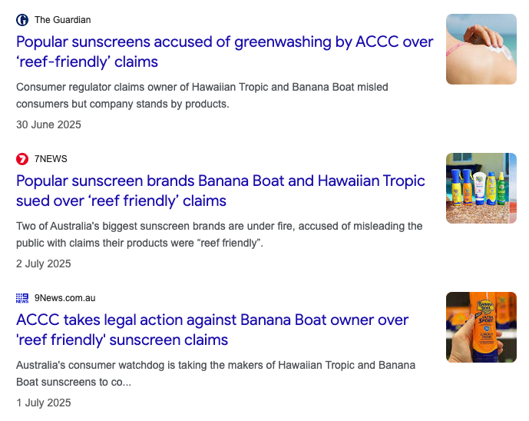
v
‘REEF SAFE’ SCANDAL
Although Banana Boat claimed its sunscreen was “reef-safe,” the Australian Competition & Consumer Commission (ACCC) found
it was NOT
Learning introduction
Notes:
SPEAKER NOTES:
What happened –
Banana Boat and Hawaiian Tropic sunscreens were advertised in Australia as “reef-safe” or “reef-friendly.”
The ACCC (Australian Competition & Consumer Commission) investigated and found the products contained chemicals known to harm coral reefs
The ACCC alleged this was misleading and deceptive “greenwashing.”
The case was filed in Federal Court in June 2025.
The scandal drew public backlash – many consumers felt misled, and environmental groups criticised the brands for using eco-friendly claims as a marketing tool.

Slide 7
v
HOW DID THEY RESPOND?
The parent company Edgewell Australia stated they:
“firmly stand by the claims it has made” (being reef safe)
And “will defend the lawsuit” in court
Learning introduction
Notes:
SPEAKER NOTES:
Optional: Ask students what they think of their response/how they should have responded
Company response –
Edgewell Personal Care Australia (the parent company) said it “stands by its claims” and will defend the case in court.
The company said it had co-operated fully with the ACCC investigation.
Around October 2023, it removed “reef-friendly” labels from its Australian packaging and advertising.
However, no public apology or recall has been issued.
Critics argue the lack of an apology shows limited accountability and highlights the importance of truthful environmental marketing.

Slide 8

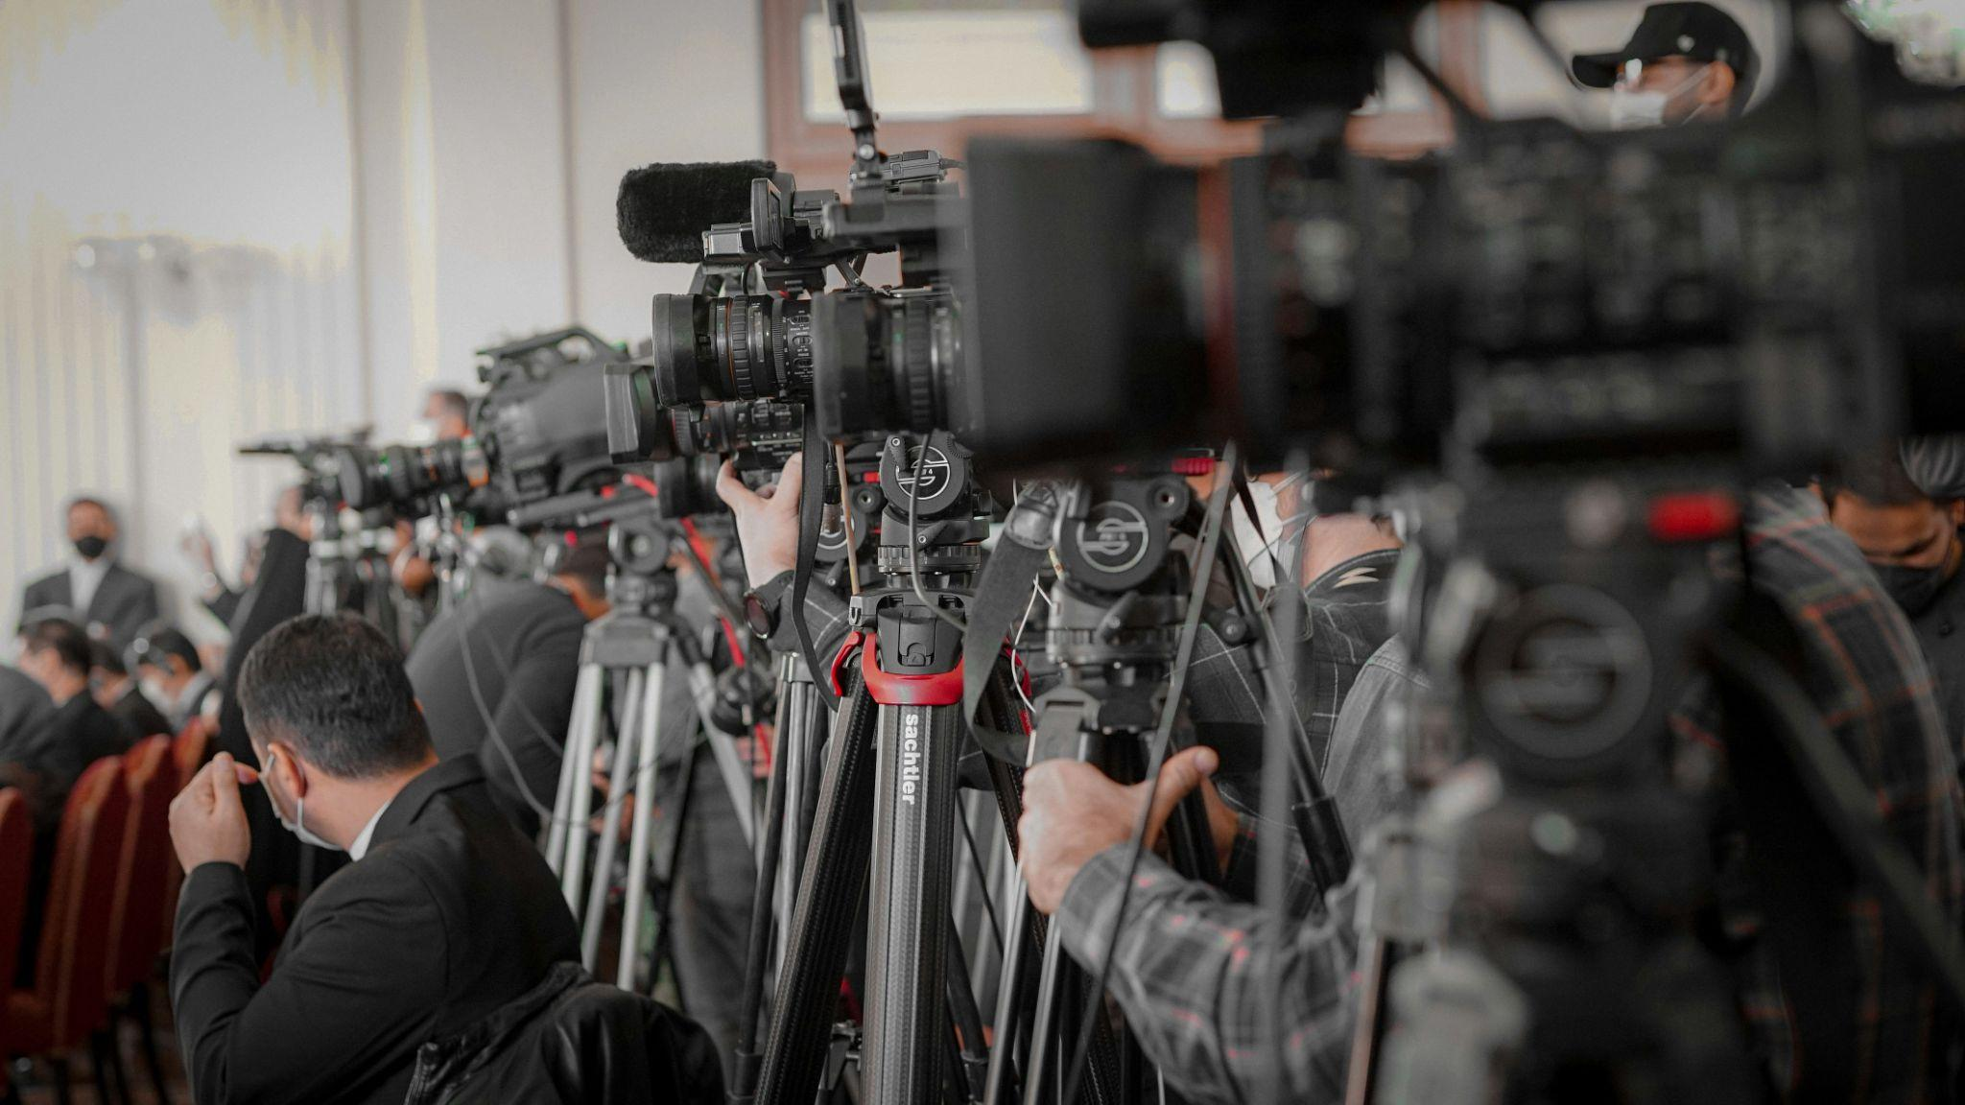
IT’S YOUR TURN TO RESPOND
Your company or organisation has had a climate scandal of its own and needs to put out a press release to the public
Working in groups, you’ll prepare and deliver a 2-minute statement responding to your assigned scenario, followed by a Q&A where classmates act as journalists questioning your company’s intentions…
v
Activity introduction
Notes:
START OF ACTIVITY, REFER TO LESSON PLAN FOR FULL INSTRUCTIONS
Note: Only 1-2 people per group have to present as the ‘spokesperson’

Slide 9
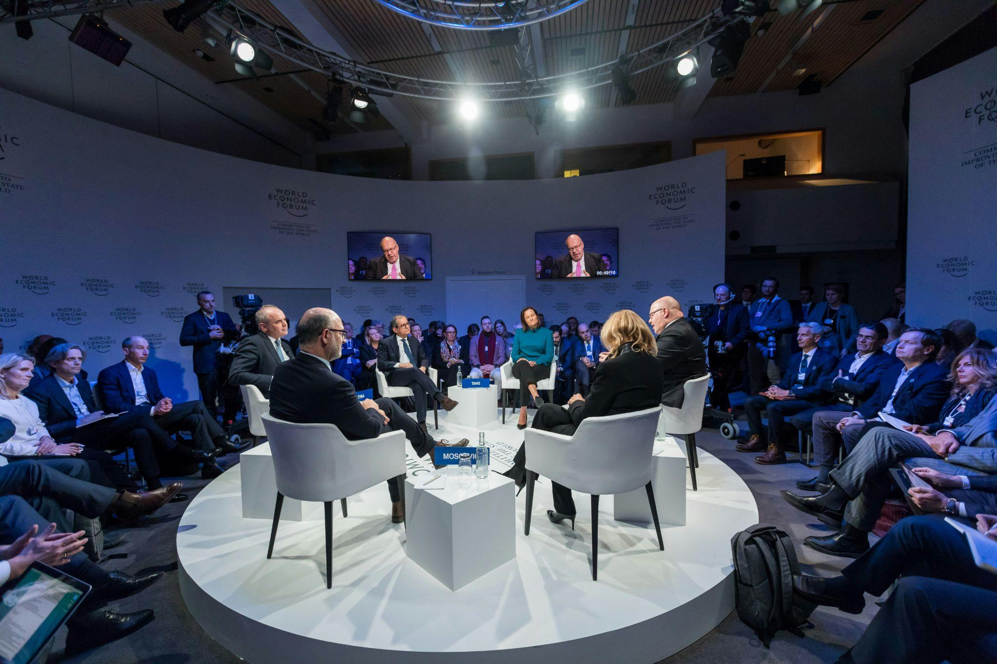
WHO’S WHO
Each group will be given a brief for one of the following groups/delivery angle:
Defensive company (mining, fishing)
Transparent organisation (not-for-profit)
PR ‘Spin Team’ for multinational companies
Activist organisation
v
Activity introduction
Notes:
REFER TO LESSON PLAN FOR FULL INSTRUCTIONS

Slide 10

TEXT ANALYSIS
Analyse the real-world press release in your brief to identify language techniques and how they are used to achieve a particular purpose
For example:
To persuade
Evoke emotion
Educate and inform
Or potentially mislead…
v
Activity
Notes:
LANGUAGE TECHNIQUE PROMPTS:
Active voice
Ad hominem attack
Alliteration
Bias
Emotive language
Euphemism
Greenwashing (more of a product of using these techniques)
Hook
Hyperbole
Imagery
Irony
Metaphor
Repetition
Statistics
Strong verbs
Structure
Titles
Tone
Vagueness

Slide 11
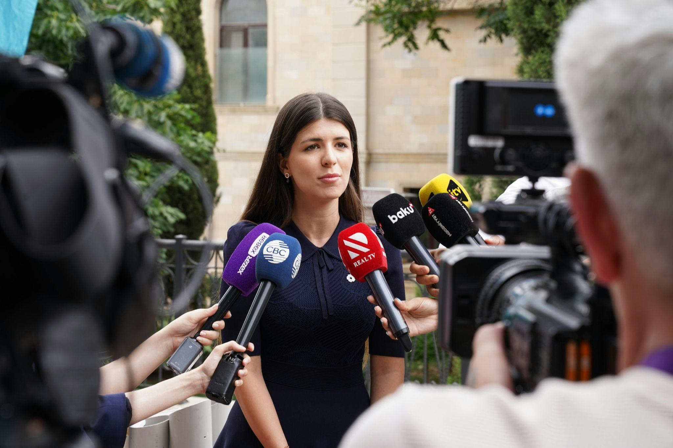
PERSONA WRITING
Using the language techniques you’ve identified, write your company’s
press release/statement (1pg max)
Consider the purpose of your statement, the message you want to convey, and how to tailor it to your audience
Remember, you’ll face a Q&A afterward, so be ready to respond in-line with your organisation’s tone and style
v
Activity
Notes:
SPEAKER NOTES:
Note: The speech is around 2 minutes long (roughly 100-200 words)
Only 1-2 people per group have to present as the ‘spokesperson’
Keep in mind their assigned persona’s ‘angle’
Defensive company (mining, fishing)
Sound professional and careful, not emotional.
Focus on facts and safety, not blame.
Use language that softens responsibility (e.g. passive voice, modality – “may have occurred”).
Avoid strong emotion – use technical terms and formal tone.
Transparent organisation (not-for-profit)
Be honest and sincere – admit mistakes and show care.
Use inclusive language (we, our) to build trust.
Focus on how you’re fixing the issue.
Use contrast and repetition (“We understand the concern, and we’re taking action.”).
PR ‘Spin Team’ (multinational)
Keep tone confident and polished.
Admit small faults but shift focus to positives (future plans, improvements).
Use positive adjectives and buzzwords (“innovative”, “sustainable”).
Avoid sounding defensive – stay calm and in control.
Activist organisation
Write with passion and urgency.
Use emotional and persuasive language to inspire action.
Highlight unfairness and demand change.
Use rhetorical questions, strong verbs, and call-to-action phrases (“We can’t stay silent.”).

Slide 12

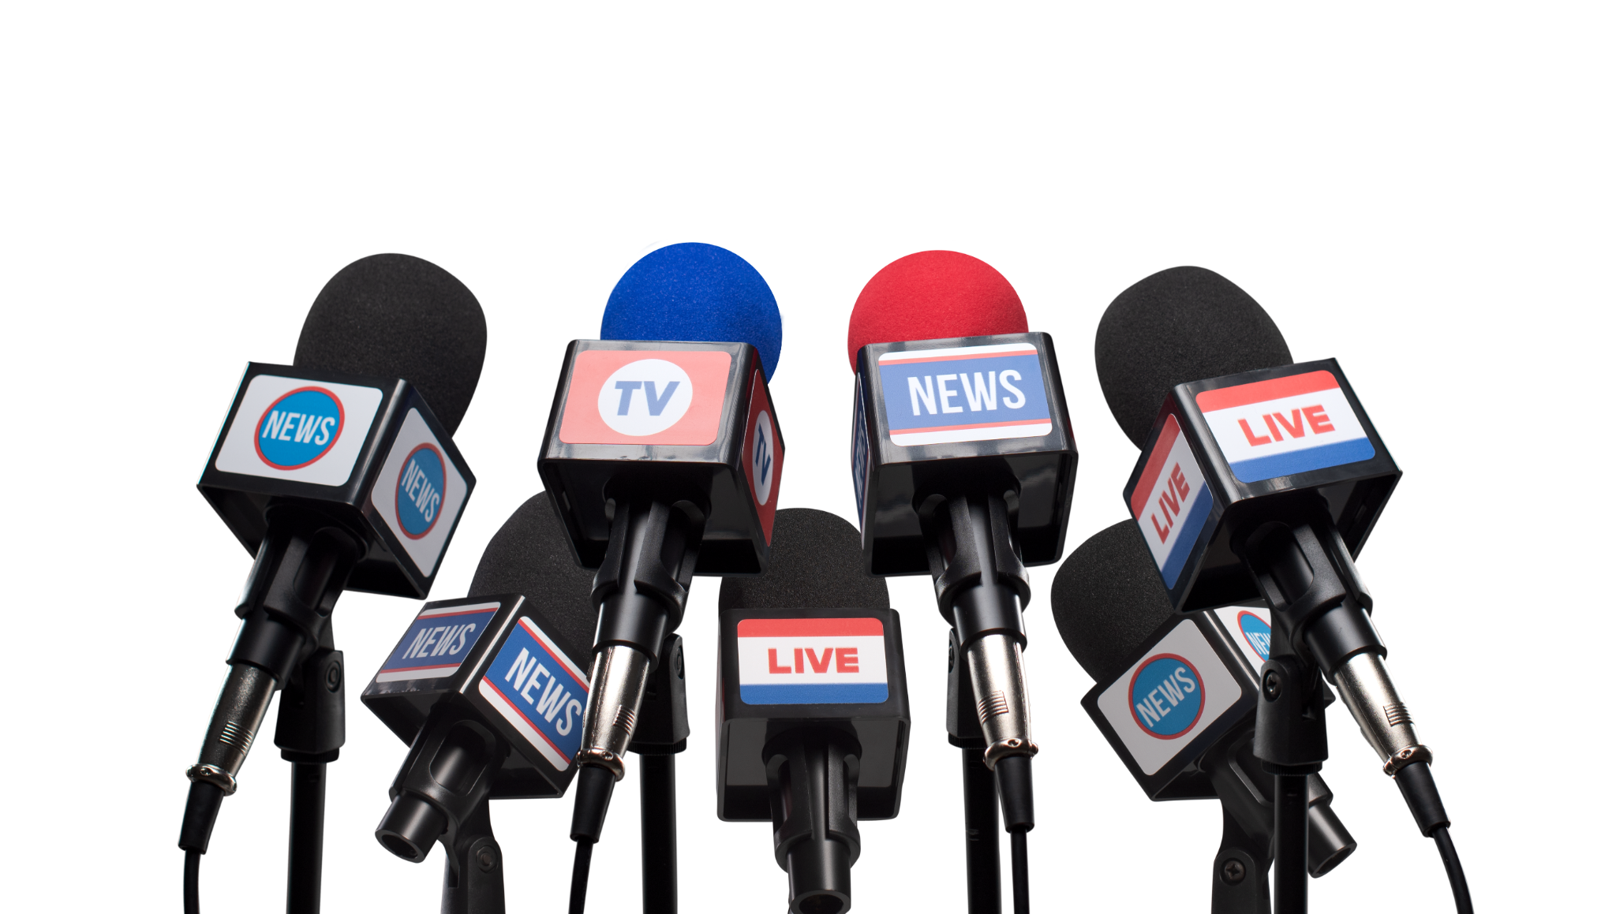
v
CLIMATE ISSUES
PRESS CONFERENCE
Activity
Notes:
JOURNALIST QUESTION PROMPTS:
What is the tone of language within the article?
Who is the blame being placed on?
What action has actually been taken since this statement was published?
Is the company being transparent?
Is there financial motive?
Who is the target audience for this statement?

Slide 13

v
REFLECTION
What language techniques were most common in positive or honest communication?
How did these help build trust or show transparency?
What language techniques were used in more deceptive or defensive communication?
How did they change the tone or hide responsibility?
What are the social or ethical impacts of
using these techniques?
How can language shape people’s values, beliefs, and attitudes — and even empower or silence certain groups?
Learning reflection
Notes:
ANSWER PROMPTS:
Positive / honest communication
Inclusive language (we, our) – builds connection and shared responsibility.
Emotive but sincere language – shows empathy and concern.
Plain, direct statements – create a sense of openness and honesty.
These techniques help audiences feel respected and build trust through clarity and accountability.
Defensive / deceptive communication
Passive voice (“mistakes were made”) – hides who’s responsible.
Euphemisms and jargon – soften or obscure the issue.
Positive spin or selective framing – distract from the problem by highlighting benefits or future plans.
These techniques protect reputation but can mislead or reduce transparency.
Social / ethical impacts
Language can shape public perception – making unethical behaviour seem acceptable.
It can empower people to demand change – or disempower them by hiding the truth.
Values and beliefs are reinforced through tone – honest language builds trust; deceptive language erodes it.
The way organisations communicate affects who is believed, who is blamed, and who feels heard.
END OF LESSON

Slide 14
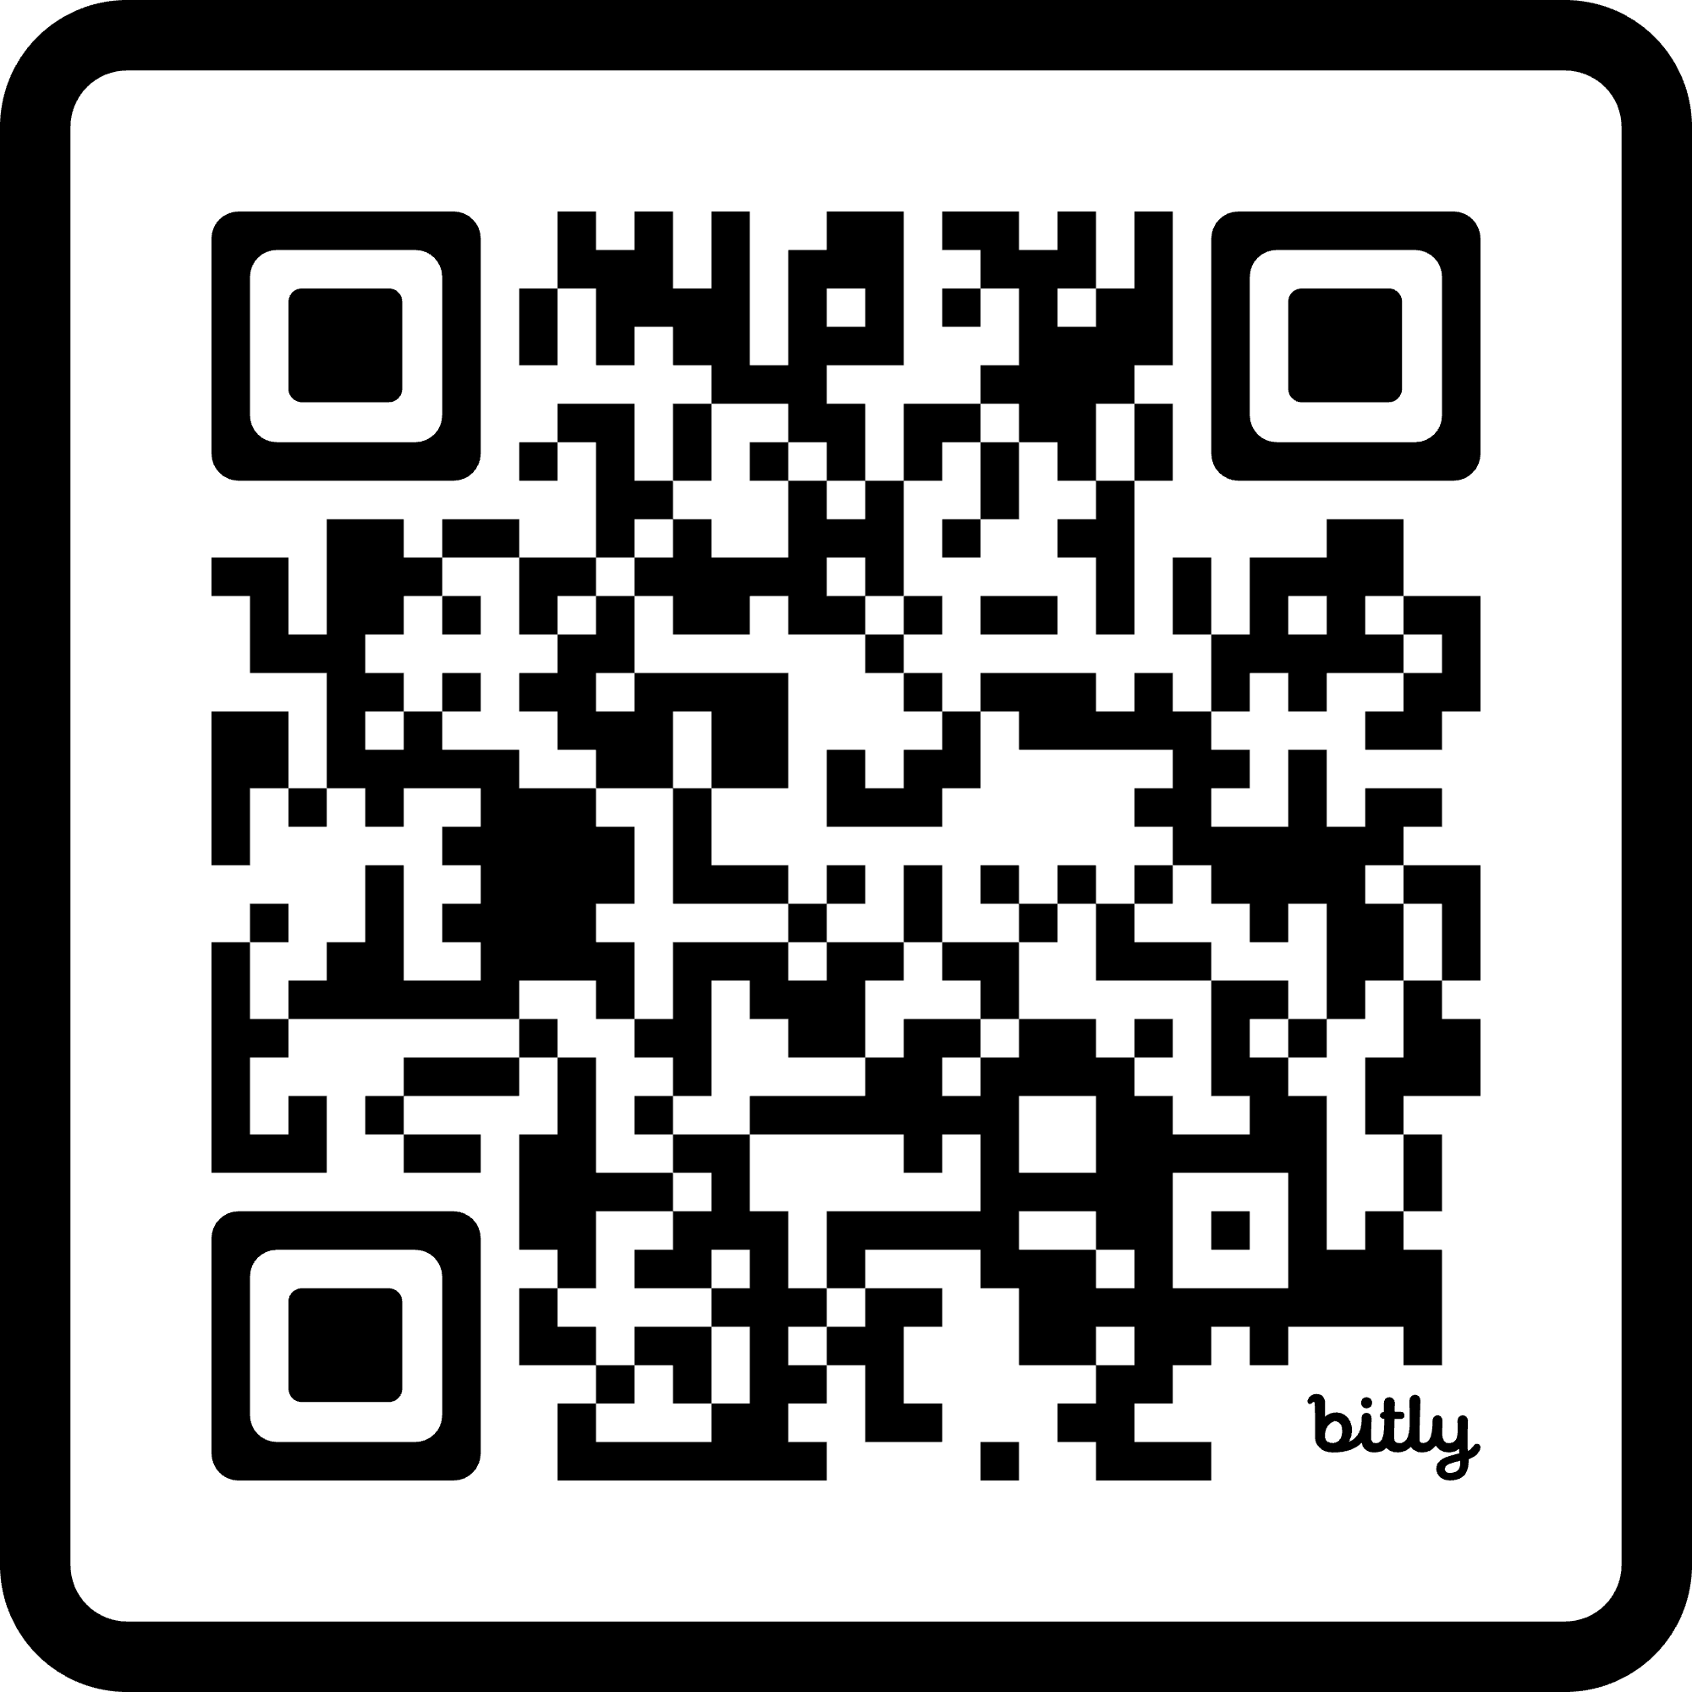
STUDENT FEEDBACK
LINK
http://bit.ly/4hV8Bka

