Slide 1



LEARNING OUTCOMES
Learning Intention
Students will be able to explain how urban planning strategies can enhance the liveability and environmental sustainability of cities and local areas, particularly in response to rising temperatures and climate change.
Success Criteria
Describe how increasing heat affects the liveability of places at
a local scale
Analyse and propose strategies to improve the environmental sustainability and climate resilience of urban areas
Develop and justify a strategy for action that considers environmental, social, and economic factors, supported by data from investigations
Notes:
Optional to show to students

Slide 2
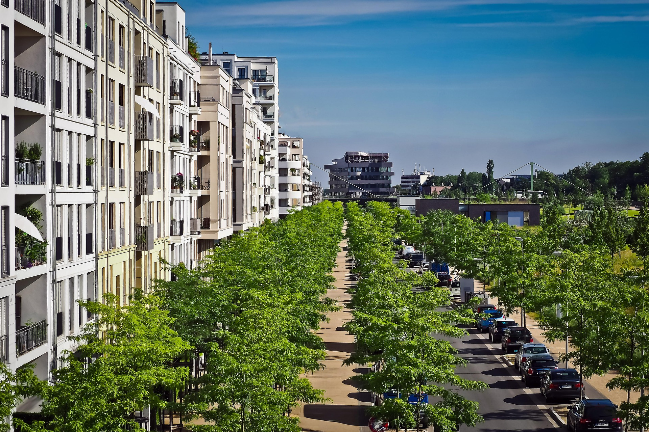

BEAT THE HEAT:
Urban planning for cooler communities in a warming world
Geography
Notes:
USE THESE SLIDES ALONGSIDE THE LESSON PLAN

Slide 3
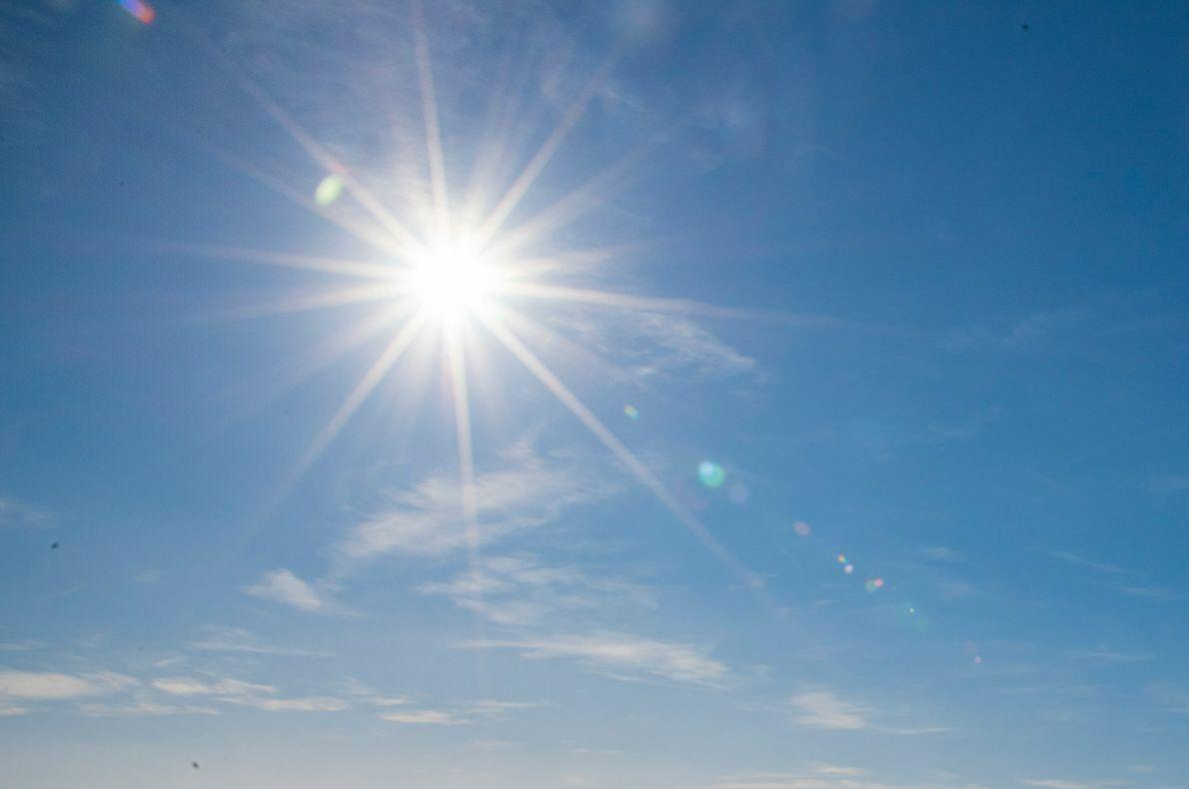


v
IS IT HOTTER
TO LIVE IN:
A- A city
B- Rural area
Learning introduction
Notes:
SPEAKER NOTES:
Have students vote by raising their hand for option A and keeping it down for option B
Optional: Ask a few students to explain why they think their answer is correct

Slide 4
v
IS IT HOTTER
TO LIVE IN:
A- A city
In Australia, cities can be on average 1–7 °C hotter than
nearby rural areas, with some places experiencing even
higher differences
Learning introduction
Notes:
ALL CONTENT ON SLIDE – Expanded theory on the following 6 slides

Slide 5
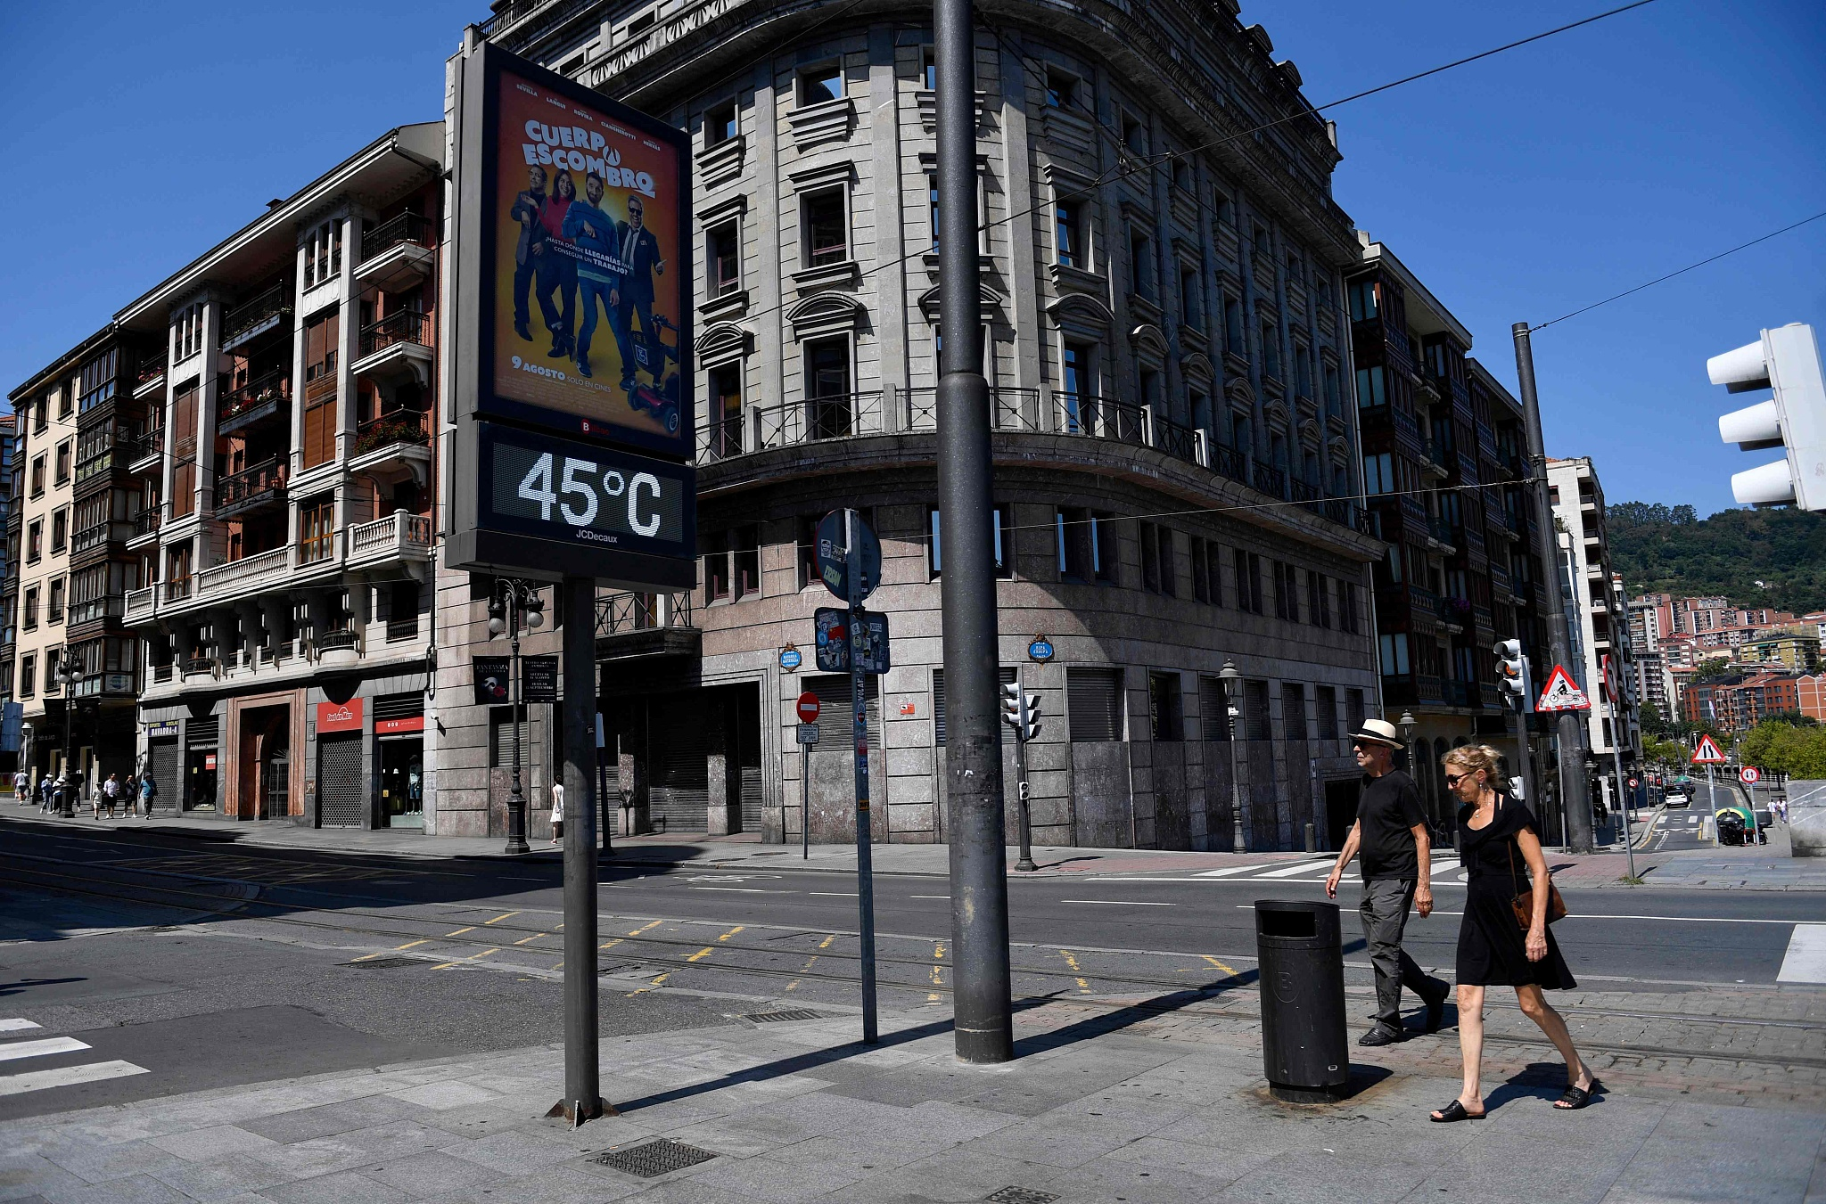
v
WHY IS IT HOTTER
LIVING IN A CITY?
Learning theory
Notes:
PROMPTS:
Think about…
Infrastructure and buildings
Recreational spaces
Transport and traffic
Population and activity levels
Energy use and technology
City layout and design

Slide 6

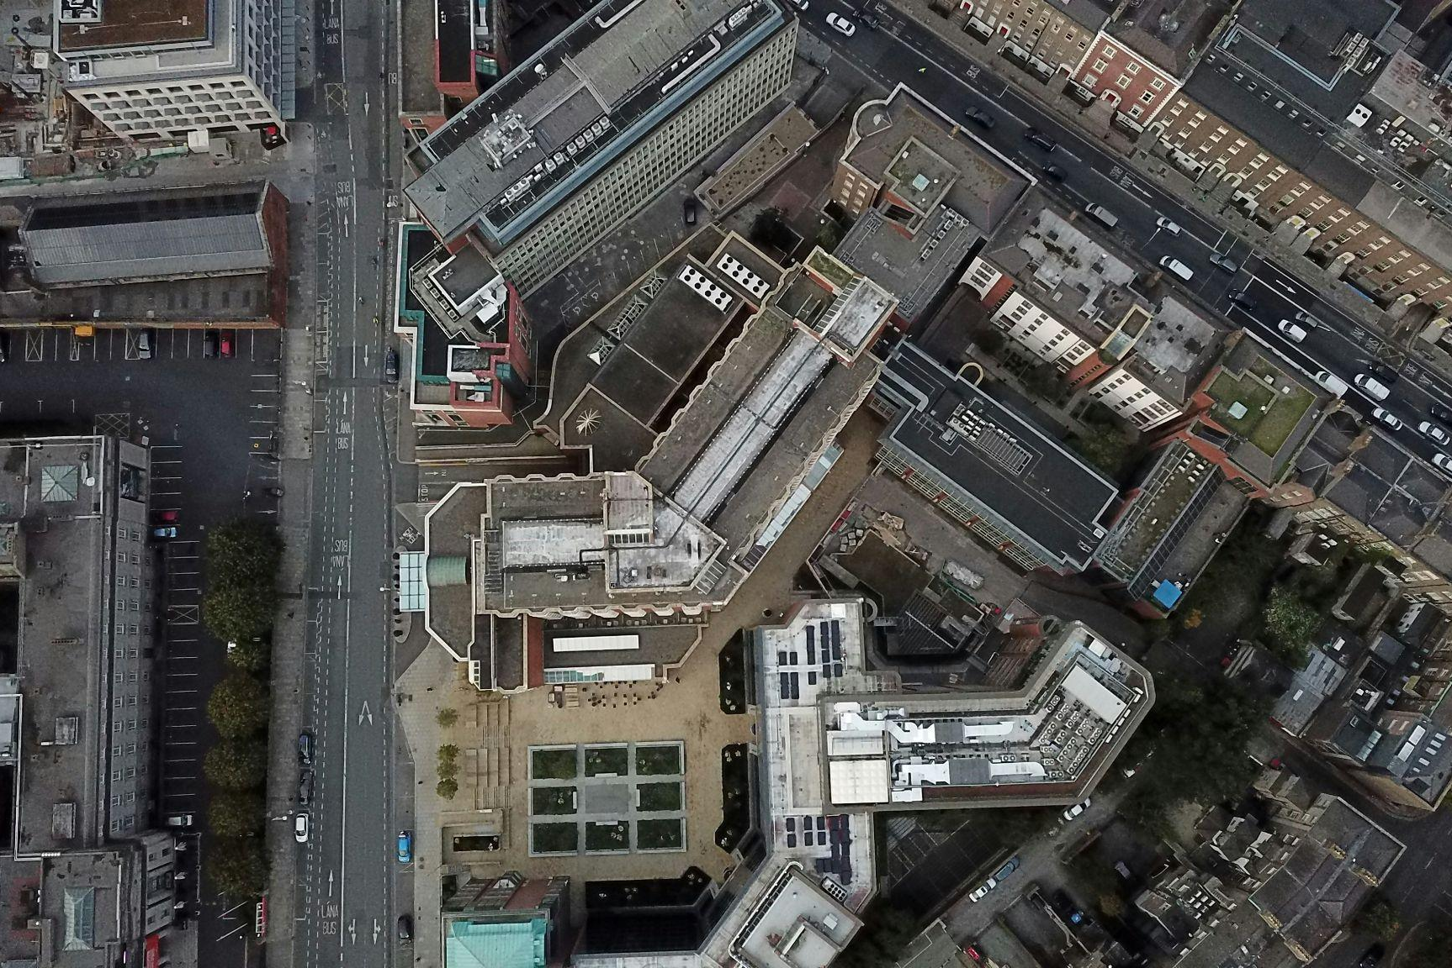

CAUSES OF INCREASED HEAT
v
Heat-absorbing surfaces
Lack of
vegetation
Human activity and infrastructure
asphalt roads
dark roofs
concrete paths
few trees
limited parks
paved courtyards
cars and trucks
air-conditioners
dense buildings
Learning theory
Notes:
SPEAKER NOTES:
Heat-absorbing surfaces – Dark materials like asphalt and concrete absorb and store more solar energy, releasing heat slowly and trapping it overnight raising urban temperatures
Lack of vegetation – Limited trees and green spaces reduce shade and evapotranspiration (the process where plants release water vapour, cooling the surrounding air), removing natural cooling and allowing heat to build up across hard surfaces
Human activity and infrastructure – Cars, air conditioners, and dense buildings release waste heat, while tall structures and narrow streets trap warm air by reducing airflow and preventing heat from escaping

Slide 7
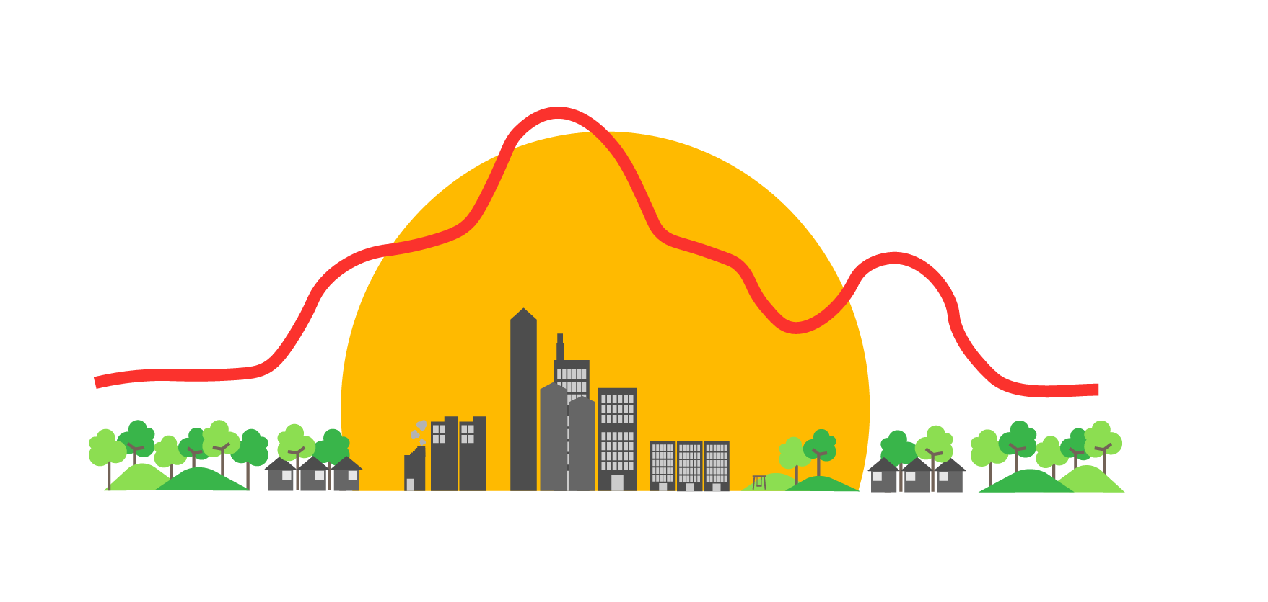
THE URBAN HEAT ISLAND EFFECT
Different regions have different climates, even on a smaller, local scale
The materials used in constructing cities absorb and re-emit more heat
This, in combination with how dense and highly concentrated cities are, creates their own microclimate that is hotter
than surrounding regions
This is known as the UHI effect
v
Learning theory
Notes:
ALL CONTENT ON SLIDE

Slide 8
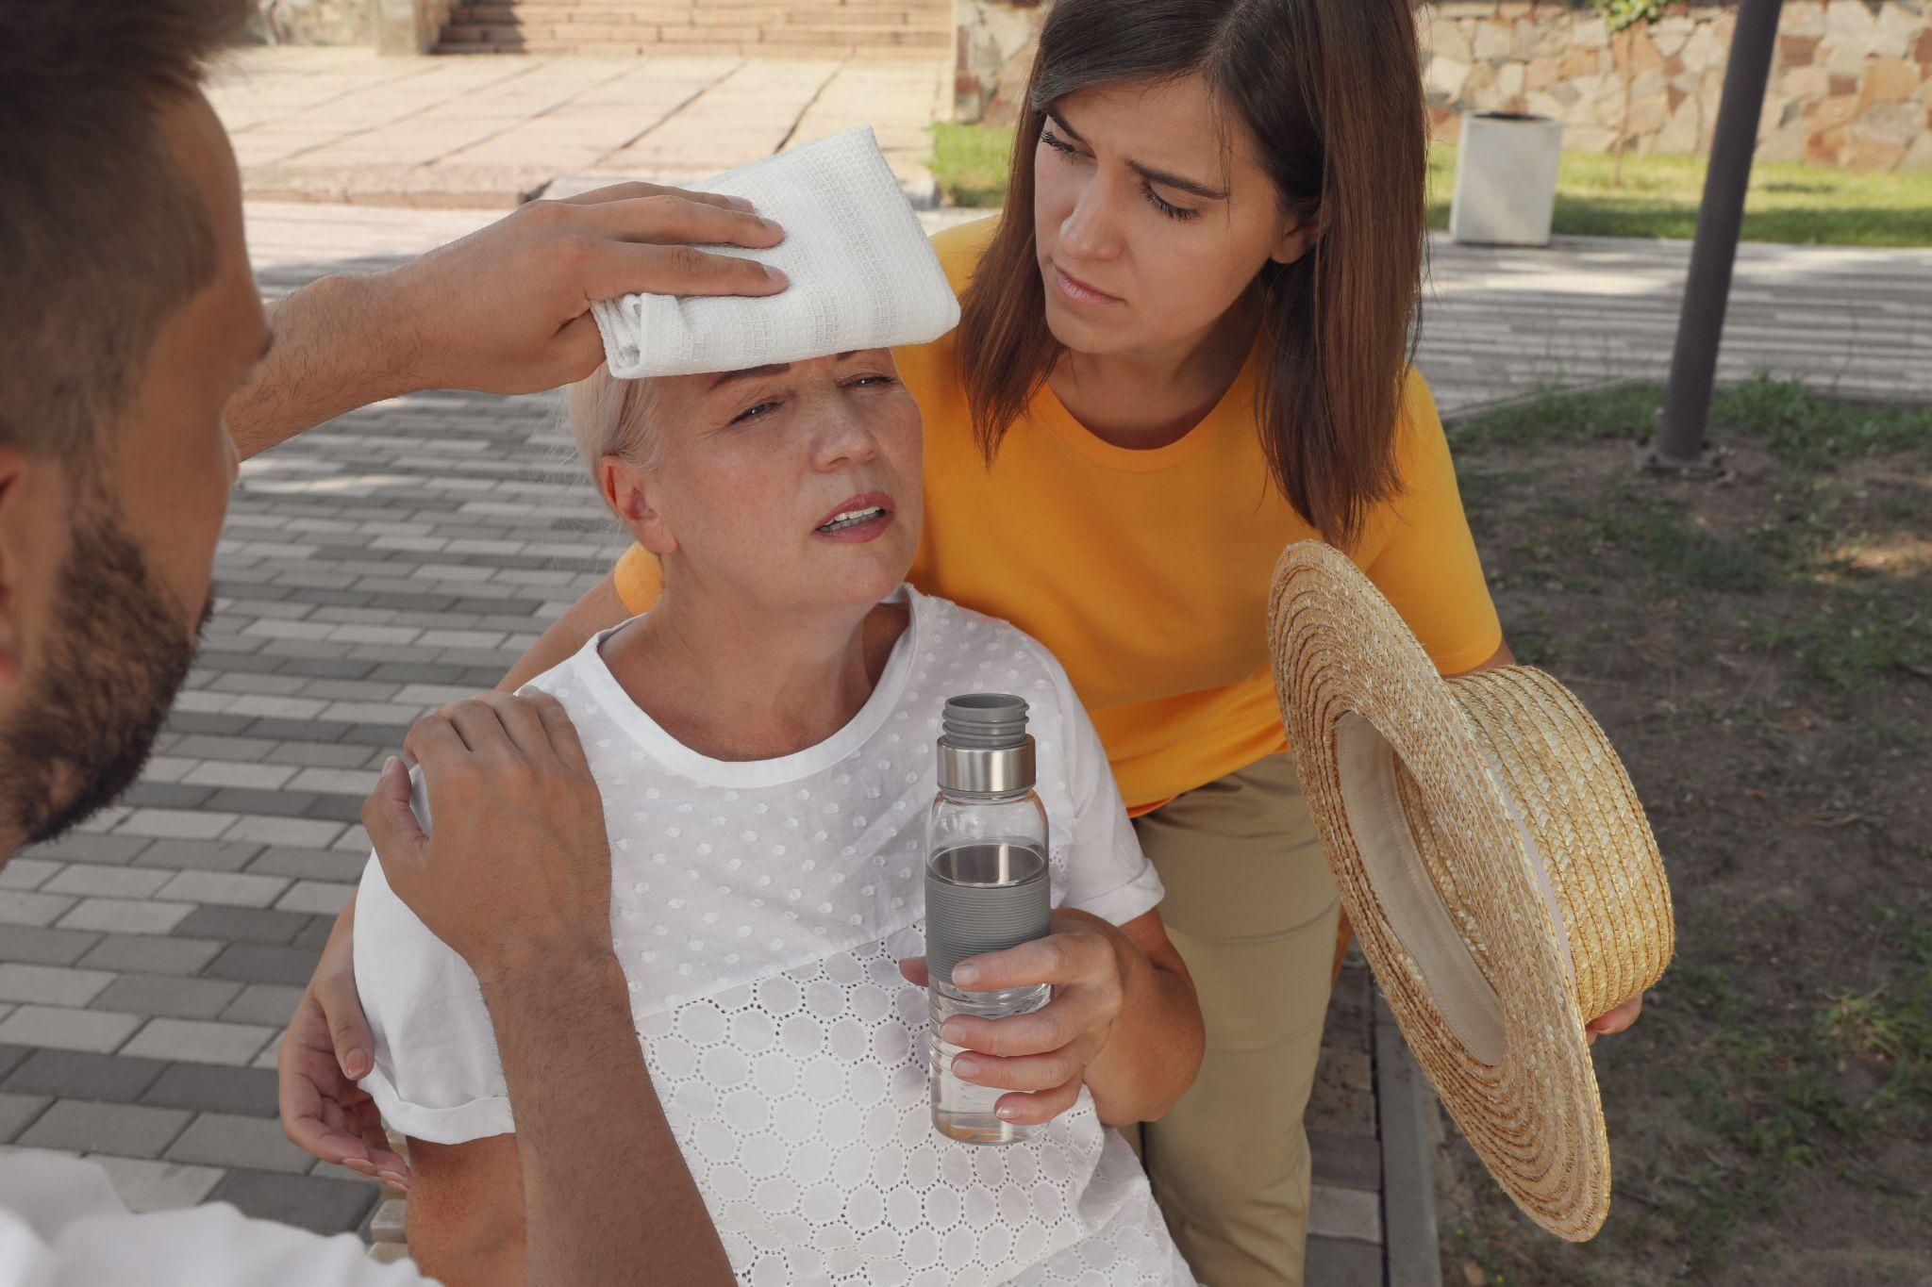
v
WHY IT MATTERS
Prolonged heat doesn’t just cause discomfort — it strains: our health, emergency services, energy systems, and the liveability of our communities
Heatwaves kill more Australians than any other extreme weather event – they are more deadly than storms, fires and floods combined
Learning theory
Notes:
ALL CONTENT ON SLIDE

Slide 9

v
HOW DO WE COUNTER THIS?
Learning theory
Notes:
PROMPTS:
Think about…
Building materials
Nature and greenery
Transport and energy use
Airflow and city design
Shade and surface colour

Slide 10
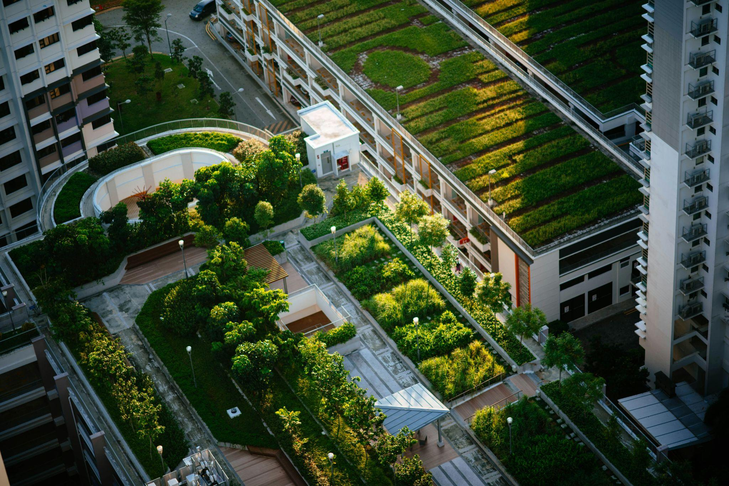
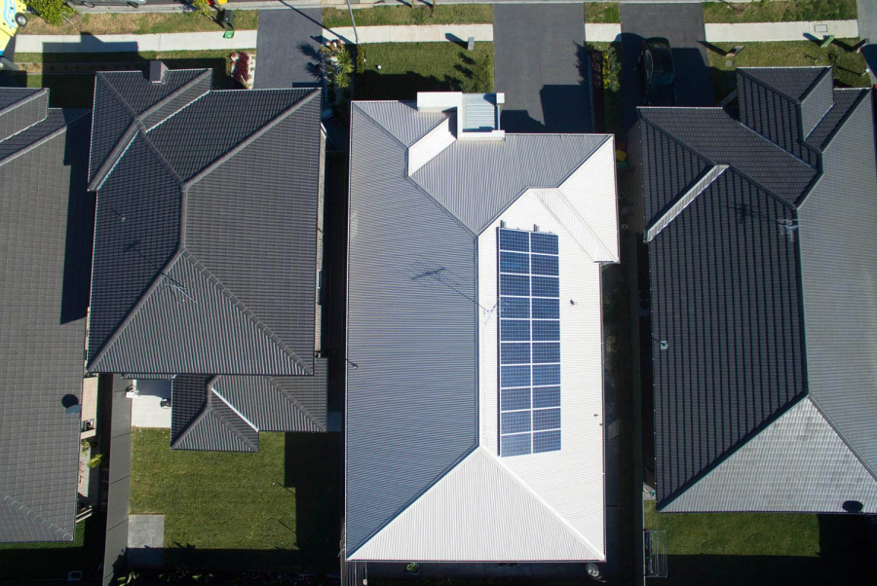
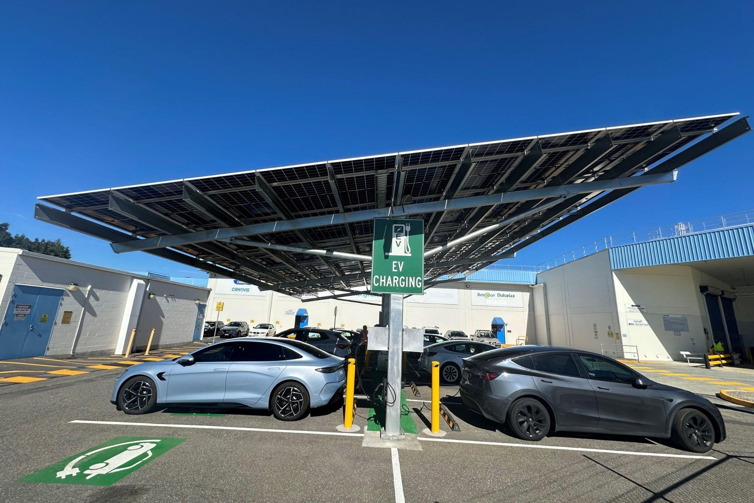
COOLING SOLUTIONS
v
Urban
greening
Different building materials
Smarter, efficient design
street shade trees
vegetated green roofs
urban cooling parks
light coloured roofs
reflective pavements
permeable surfaces
shaded walkways
EVs + public transport
renewable energy (solar)
Learning theory
Notes:
SPEAKER NOTES:
Urban greening – Trees, green roofs, and urban parks provide shade and cool the air through evapotranspiration (plants releasing water vapour). More vegetation also improves air quality and makes cities more comfortable during heatwaves.
Different building materials – Light-coloured, reflective, and permeable materials absorb less heat and release it faster. “Cool roofs” and reflective pavements lower surface temperatures, while permeable surfaces help water evaporate and cool the air. (can also explain the ‘Albedo effect’ during this point)
Smarter, efficient design – Planning for shade, natural airflow, and sustainable transport (including electric vehicles) reduces trapped heat. Energy-efficient buildings, renewable energy, and better public transport lower emissions and waste heat from vehicles and air conditioners.

Slide 11


ACTIVITY pt.1:
BEAT THE HEAT
Which surfaces soak up the sun and which ones keep their cool?
Working in groups, you’ll compare the rate at which an ice cube melts on four different surfaces as you explore how colour and material type influence heat absorption
v
Activity introduction
Notes:
REFER TO LESSON PLAN FOR FULL INSTRUCTIONS

Slide 12
v
EXPERIMENT INSTRUCTIONS
Place the first surface (black card, white card, foil, or mirror) on a plastic tray
Put one ice cube in the centre and position the tray around 20–30 cm below the light source (or in direct sunlight)
Start your timer and observe how the ice melts, recording the time when:
  melting begins
  a 1 cm puddle forms
  the ice fully melts
Repeat the test for each remaining surface, keeping all other conditions
the same
v
Activity instructions
Notes:
REFER TO LESSON PLAN FOR FULL INSTRUCTIONS

Slide 13

ACTIVITY pt.2:
COOLER COMMUNITIES
Develop a council submission proposing ways to cool and improve a local urban area
Use your area map and personas to guide your recommendations, focusing on designs that balance function, sustainability, and community comfort
v
Activity introduction
Notes:
REFER TO LESSON PLAN FOR FULL INSTRUCTIONS

Slide 14
v
SUBMISSION SUMMARY
Site & Issue – Describe your assigned area and the main heat problem
Evidence – Add your ice-melt test results and graph to show what you found
Recommendations – Suggest 3–5 practical design actions to reduce heat
Stakeholder Impact – Explain who benefits and how (using your personas)
Call to Action – End with a persuasive plea asking Council to adopt your plan
Attach – Include your A3 redesign plan of the area
v
Activity instructions
Notes:
REFER TO LESSON PLAN FOR FULL INSTRUCTIONS

Slide 15
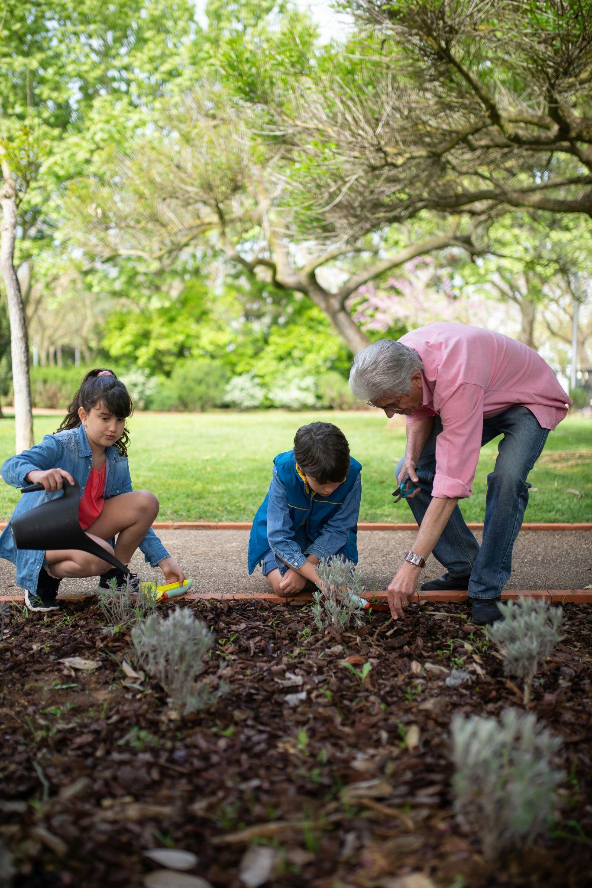
v
MAKING CHANGE
How feasible are these recommendations to implement?
What local actions could help make them happen?
Learning introduction
Notes:
ANSWER IDEAS:
Feasibility:
Low-cost and quick: planting trees, adding shade sails, painting roofs lighter colours.
Major funding and long-term: redesigning streets, updating materials, improving public transport networks.
Barriers: limited budgets, lack of space, competing council priorities, and community or planning approval processes.
Councils must balance costs, safety, and equity when prioritising actions.
Local actions:
Community initiatives: tree planting days, local greening or cooling projects.
Partnerships: schools, councils, and businesses collaborating on pilot programs.
Efficient cooling: using energy-efficient air conditioners or heat pumps, shading homes, and moderating indoor temperatures to reduce waste heat.
Individual actions: choosing active transport and supporting local sustainability campaigns
Policy support: councils adopting design standards or targets for shade and canopy cover.
END OF LESSON

Slide 16

STUDENT FEEDBACK
LINK
http://bit.ly/4hV8Bka

