Slide 1
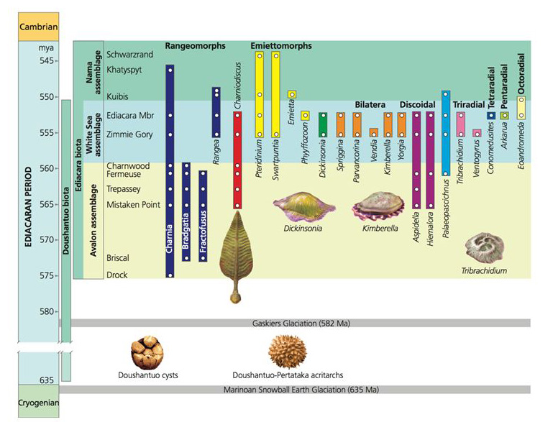
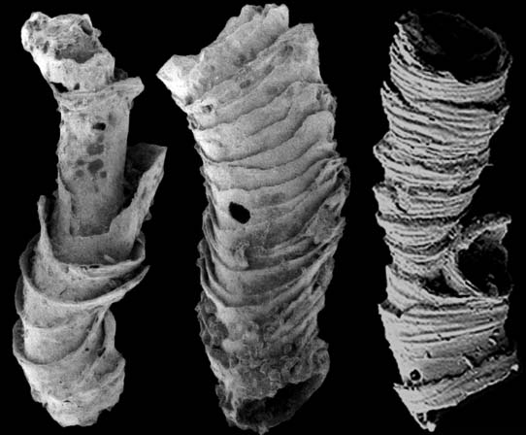
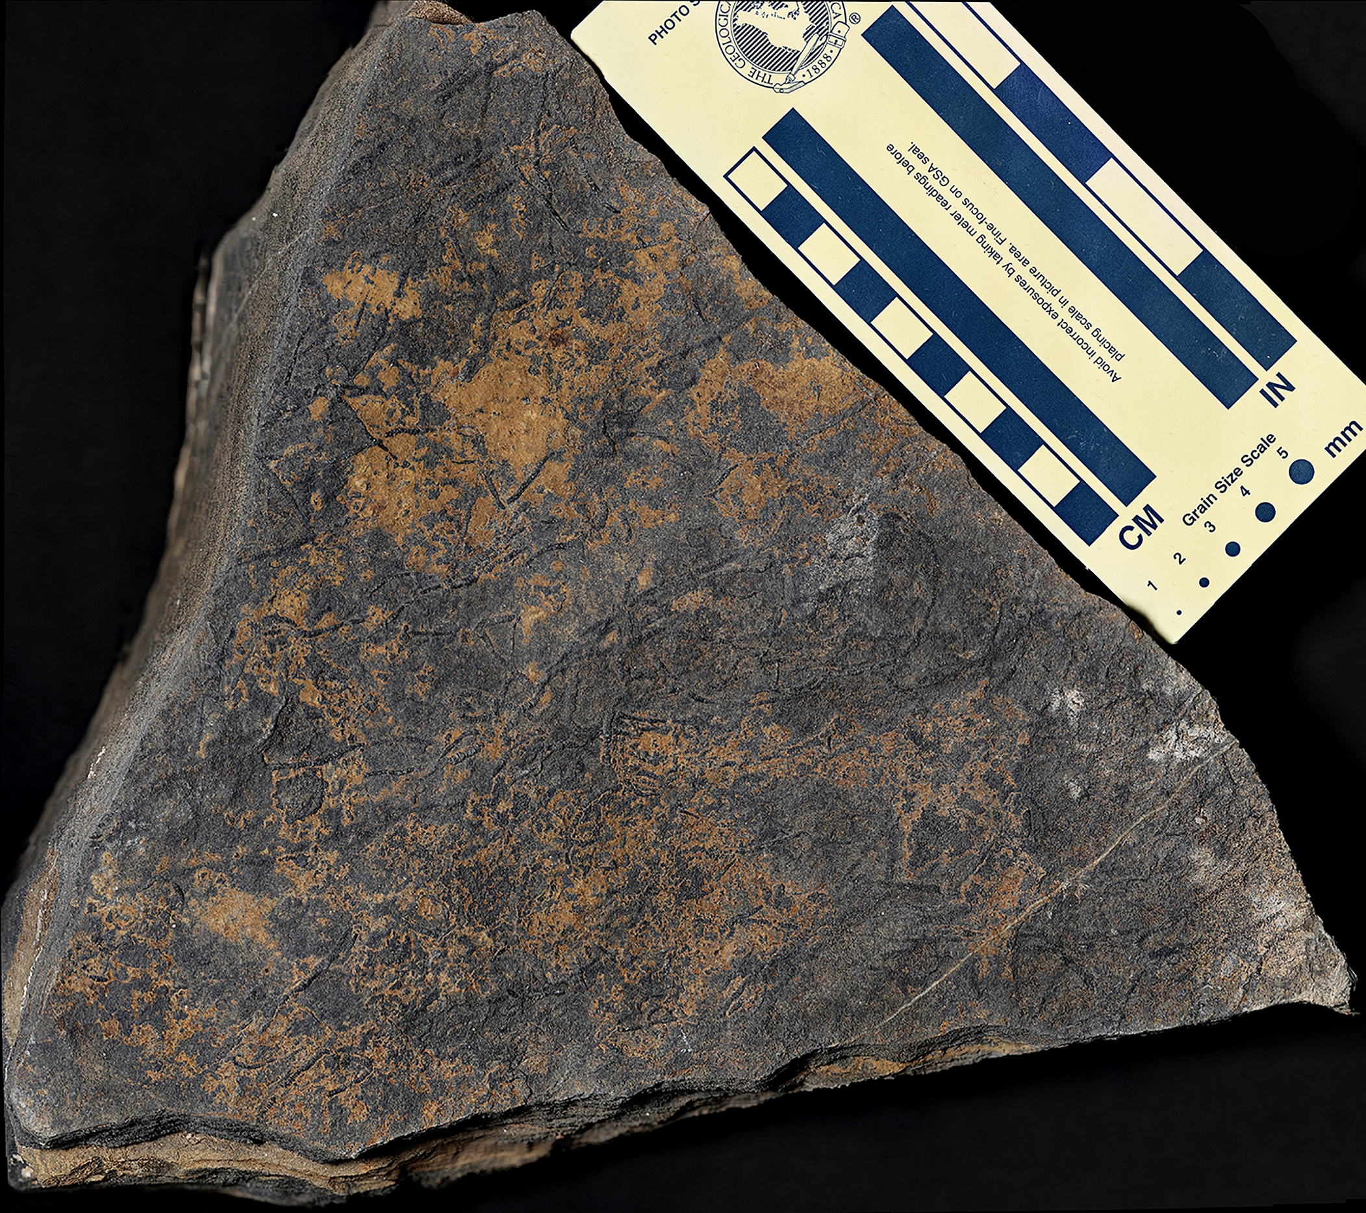
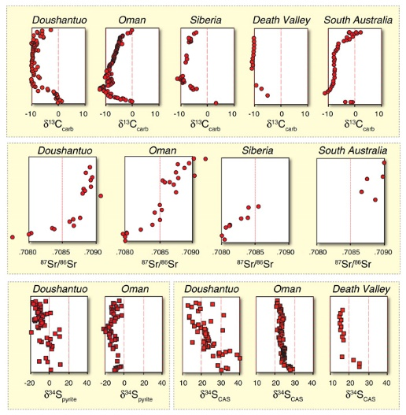
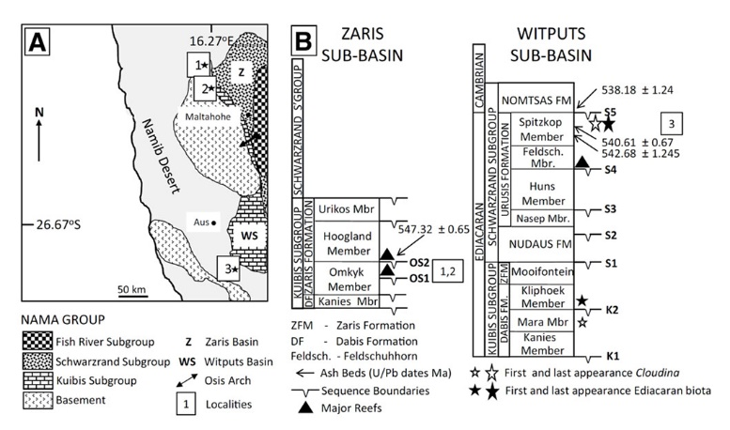
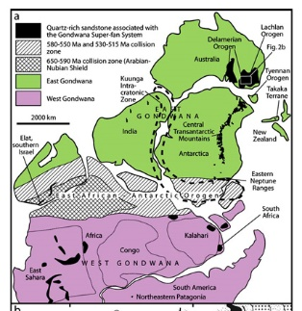
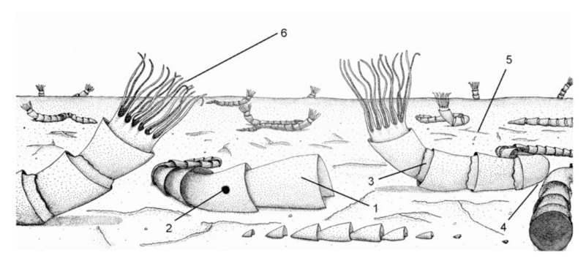
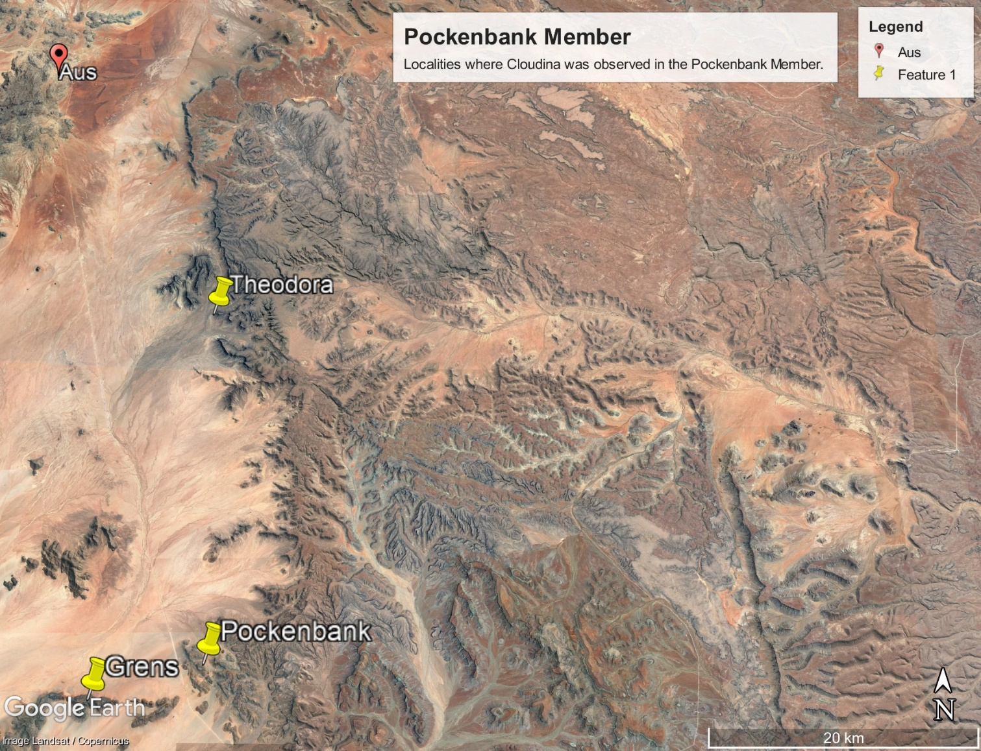
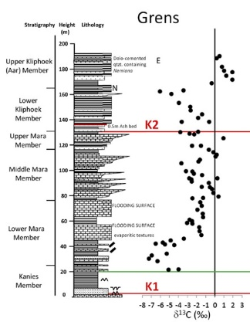
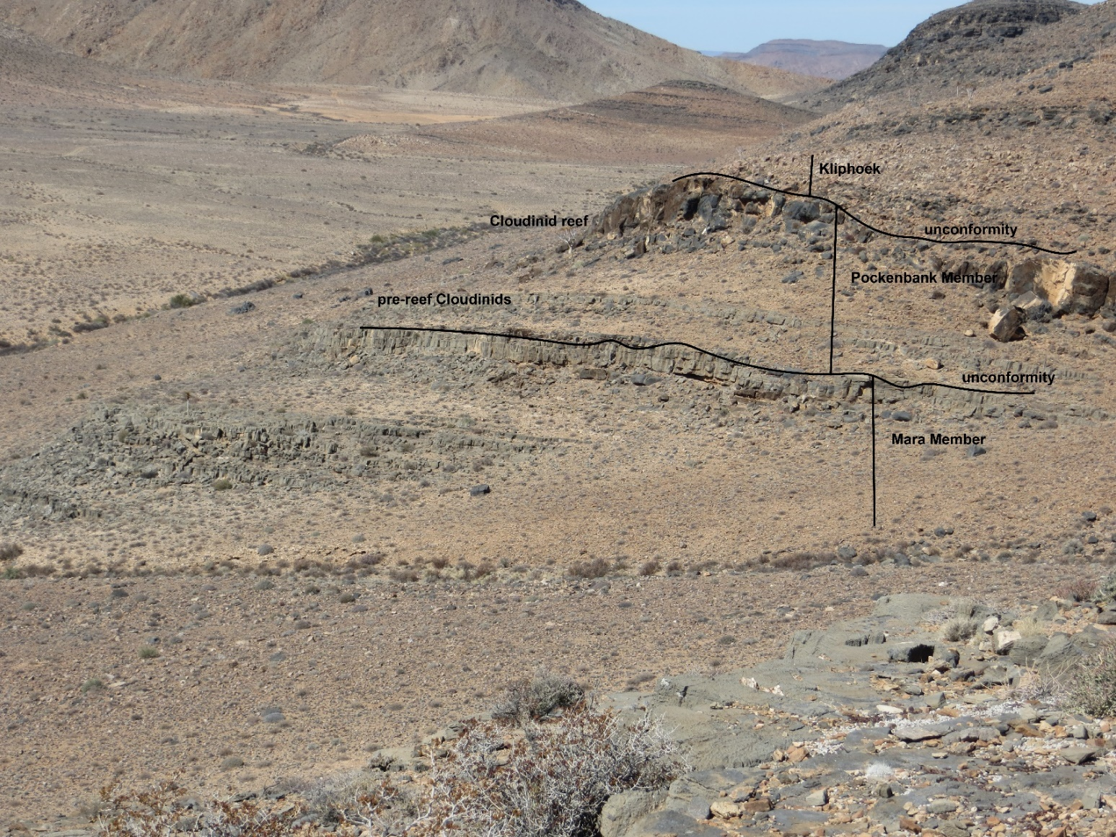
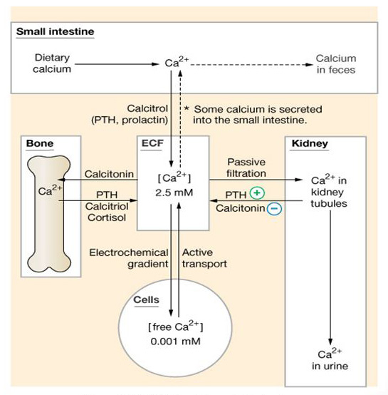
When Life got Hard: An Environmental Driver for Metazoan Biomineralization
1
Alan J. Kaufman, University of Maryland, Geology Department
Les Kriesfeld and Patricia Vickers-Rich, Monash University, Department of Earth, Atmosphere, and Environment
Guy Narbonne, Queen’s University, Department of Geological Sciences and Geological Engineering
The Ediacaran sub-commission is currently subdividing the period into stages. A critical biological event that could be used to define a critical boundary is the first appearance of biomineralized carbonate shells of Cloudina.
Given the template-directed mineralization of their funnel-in-funnel carbonate shells, Cloudina is considered the earliest complex multicellular metazoan. The tubular Ediacaran fossil has a global distribution, but is best known from the Nama Group in southern Namibia. We have recently re-discovered the fossil in a newly-recognized unconformity-bounded sequence above the Mara Member of the lower Nama Group in three locations south of Aus. Cloudina here occurs as individual cones floating in a micritic matrix, as strings of stacked cones on bedding surfaces, and as lithified micro-reefs in intimate association with microbial mats. The occurrence of Cloudina immediately above the Mara Member is critical insofar as this unit preserves evidence for the greatest negative carbon isotope anomaly in Earth history – the Shuram Excursion – when Ediacaran oceans were broadly ventilated and oxic conditions likely prevailed in shallow marine environments by the end of the biogeochemical perturbation. Given the global distribution of the Shuram Excursion, its stratigraphically cohesive pattern of carbon isotope change, and its preservation in a wide range of environments, the carbon isotope excursion may be understood in terms of the pulsed addition of ¹²C-rich alkalinity to the oceans. The driver of the biogeochemical anomaly and the onset of biomineralization is envisioned as tectonic in nature, and related to widespread Pan-African orogeny as East and West Gondwana were sutured. Erosion of uplifted Ediacaran terrains delivered thick piles of sediments to the oceans, as well as bio-limiting nutrients, especially N, P, and Fe, sulfate, and carbonate alkalinity produced through silicate weathering. The ¹²C-rich alkalinity may alternatively have built up in anoxic seawater through microbial sulfate reduction promoted by the weathering flux of sulfate to the oceans and a vast reservoir of dissolved organic carbon. Our regional chemostratigraphic analysis documents the final recovery from the Shuram Excursion within the newly-described sequence suggesting that shallow seawater had become oxidizing in this interval. The sudden appearance of biomineralized metazoans thus appears to reflect a rapid change in the redox state and the concentration of alkalinity in the immediate post-Shuram ocean.
Xiao and Laflamme, 2009
2
The funnel-in-funnel morphology of Cloudina is distinctive, but it is uncertain what drove these animals to biomineralize. Hypotheses include: 1) protection from predation, 2) structural support, and 3) calcium regulation.
5
7
3
Cloudina is preserved in the Arasab Member at the top of microbialites mounds as long serpentine strings of the funnel-in-funnel fossils (and also intimately intergrown with microbialites in micro-reefs). These relationships suggest that the organism grew recumbently along the mat surface and did not require structural support for orientation in currents.
Globally distributed, the Shuram Excursion is also characterized by profound excursions in the sulfur and strontium cycles, suggestive of the growth of the marine sulfate reservoir (and of nutrients and weathering derived alkalinity) associated with the uplift and subsequent erosion of the Transgondwana Supermountain
Cloudina was first widely described in the Nama Group of southern Namibia by Germs in his 1968 PhD, but its FAD in the Mara Member has not been relocated in the 50 years since.
Wood et al., 2015
Cui et al., 2016
8
4
The physical and chemical erosion of uplifted terrains delivered thick blankets of sediments, as well as nutrients, sulfate, and alkalinity (including Ca²⁺) to the middle Ediacaran oceans.
Recent field work in localities south of Aus has led to the discovery of an unconformity bounded sequence above the Mara and below the Kliphoek Sandstone that preserves Cloudina. We have tentatively named this unit the Arasab Member.
Becker-Kerber et al., 2017
Theodora
Squire et al., 2006
6
9
Carbon isotope studies of lower Nama Group strata indicate that Cloudina in the Arasab Member appears at the termination of the Shuram Excursion, the greatest negative carbon cycle anomaly in Earth history.
Calcium concentration is highly regulated in animals, with cellular levels <1000x blood concentrations. Excess Ca²⁺ is either excreted, or stored in bones and shells. In the immediate aftermath of the Shuram Excursion, animals would have to contend with high alkalinity and Ca²⁺ in seawater, likely developing carbonate shells for the first time in Earth history.
PP41D-1869
Wood et al., 2015

