Slide 1
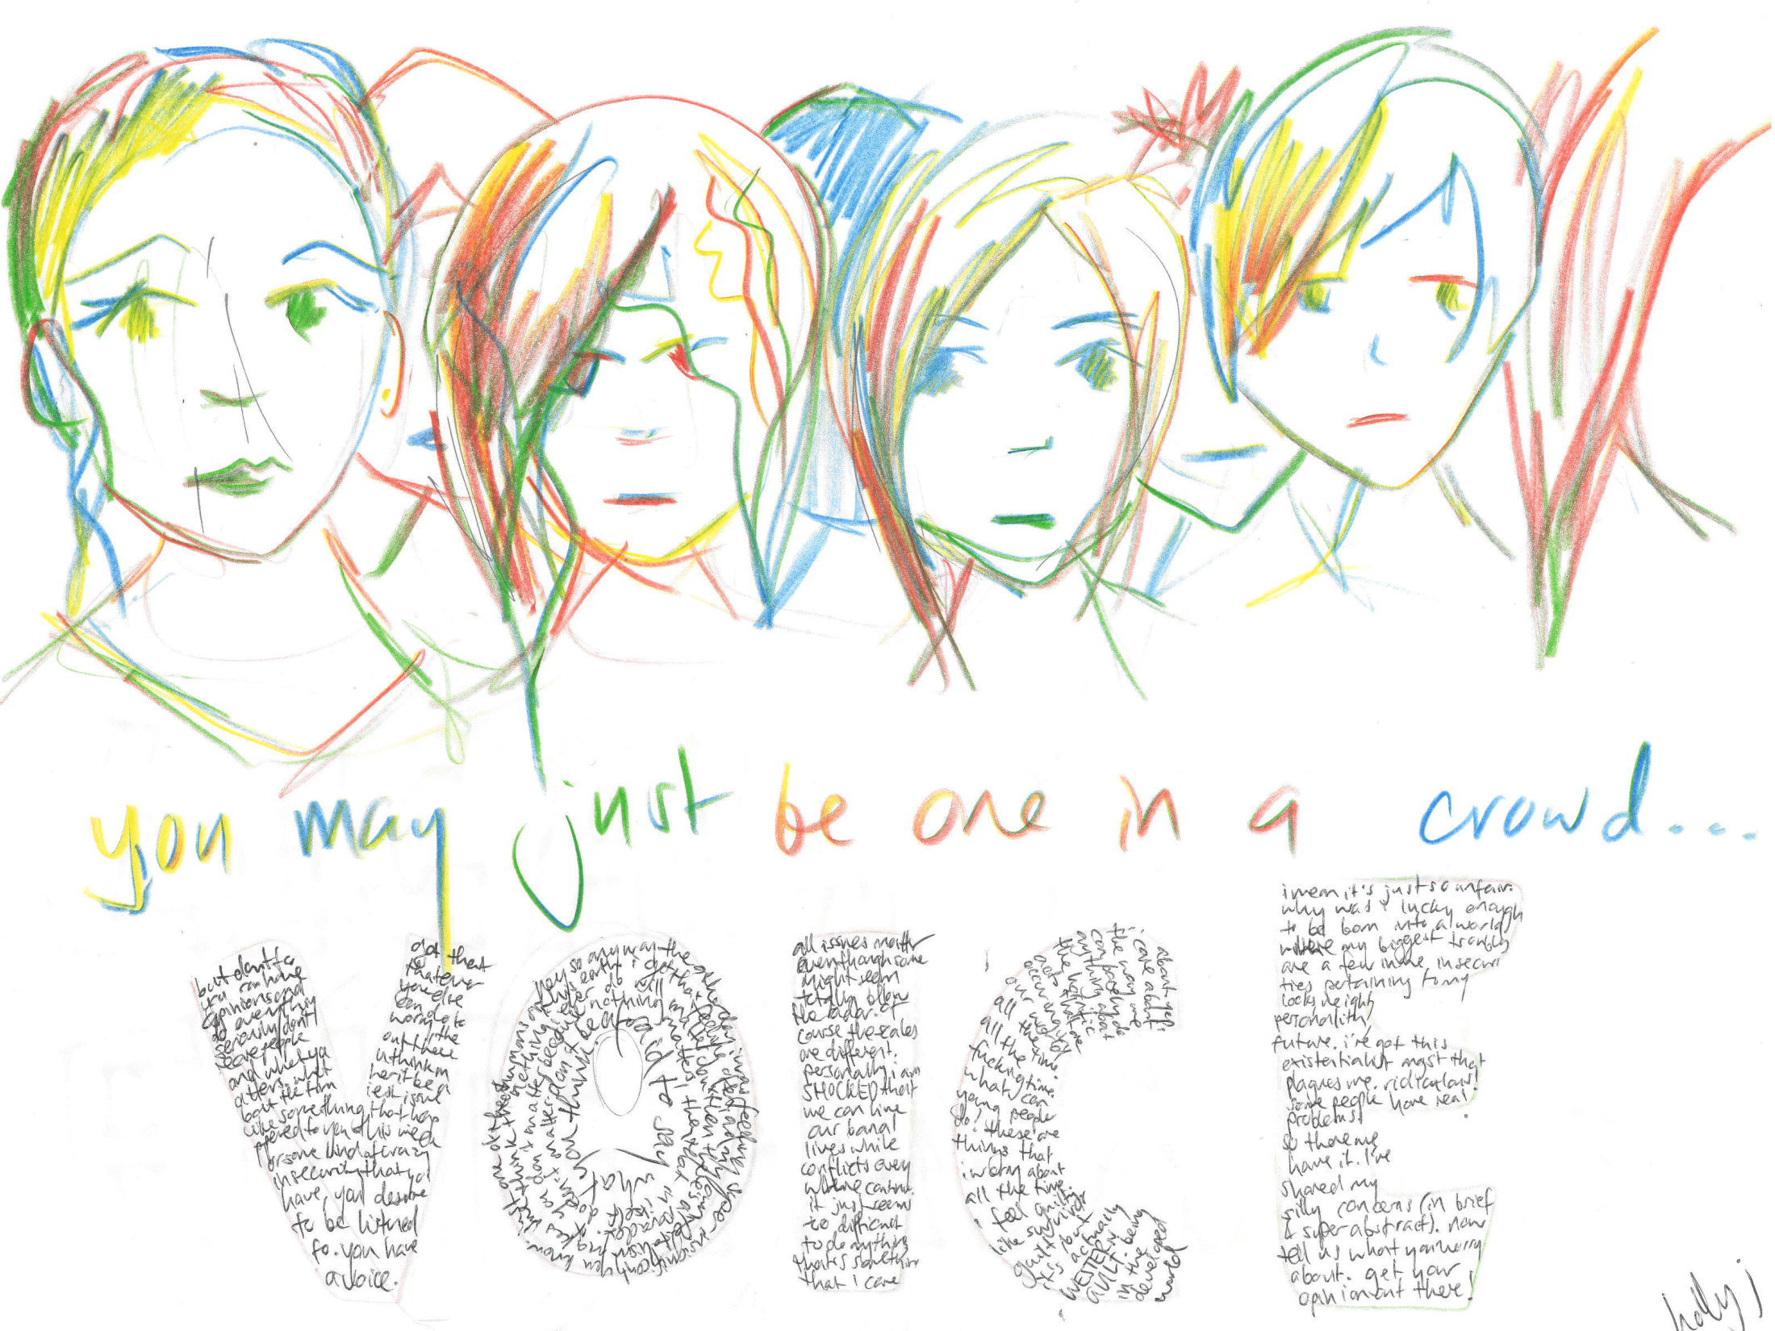

Slide 2
Listen to Children Report
Available to download at www.childrights.org.au
Why write a Shadow Report?
    ‘Charlotte’s Story’

Slide 3
Process
Strategic Directions Workshop (December, 2010): Developed ‘Listen to Children’ theme
Youth consultation: Youth survey (628 respondents), workshops, existing strategies
Advice from experts and research groups
Project Team: Led by King Wood Mallesons (December – June)
Public events in Canberra, Melbourne, Sydney and Perth
Key advocacy ask: National Children’s Commissioner

Slide 4
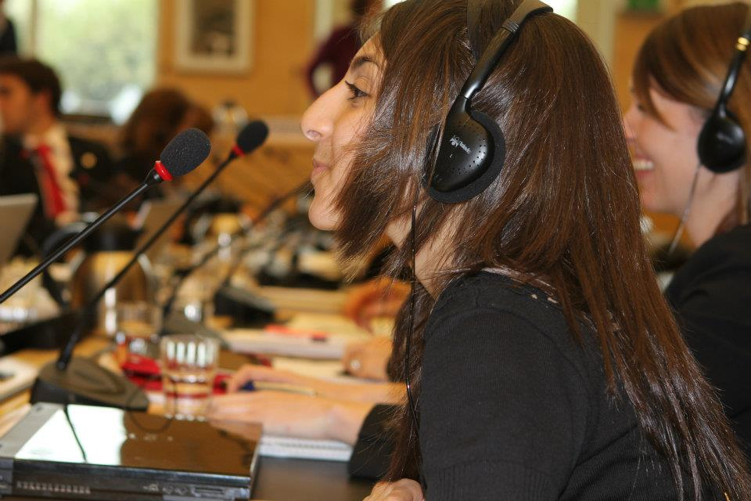

Slide 5
Listen to Children Core Priorities
Children in Out-of-Home Care (link between leaving care and homelessness: increase by 51% since 2005)
Children in juvenile detention (Indigenous children are 28 times more likely to be incarcerated)
Participation of children with disabilities
Children in immigration detention (third country processing, guardianship, community detention, etc)
Anchor: National Children’s Commissioner

Slide 6
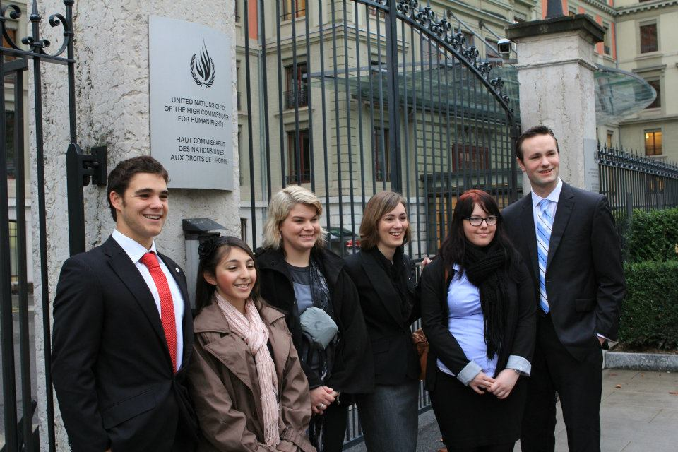

Slide 7
NGO pre-sessional, October, Geneva
3 hours on Australia’s implementation of the CRC
3 hours on Australia’s implementation of the OPAC and OPSC
Delegation consisted of child focused NGOs, academics and youth advocates
Special youth presentation to the CRC Committee
Side events
Core purpose – building Australia’s children’s rights movement

Slide 8
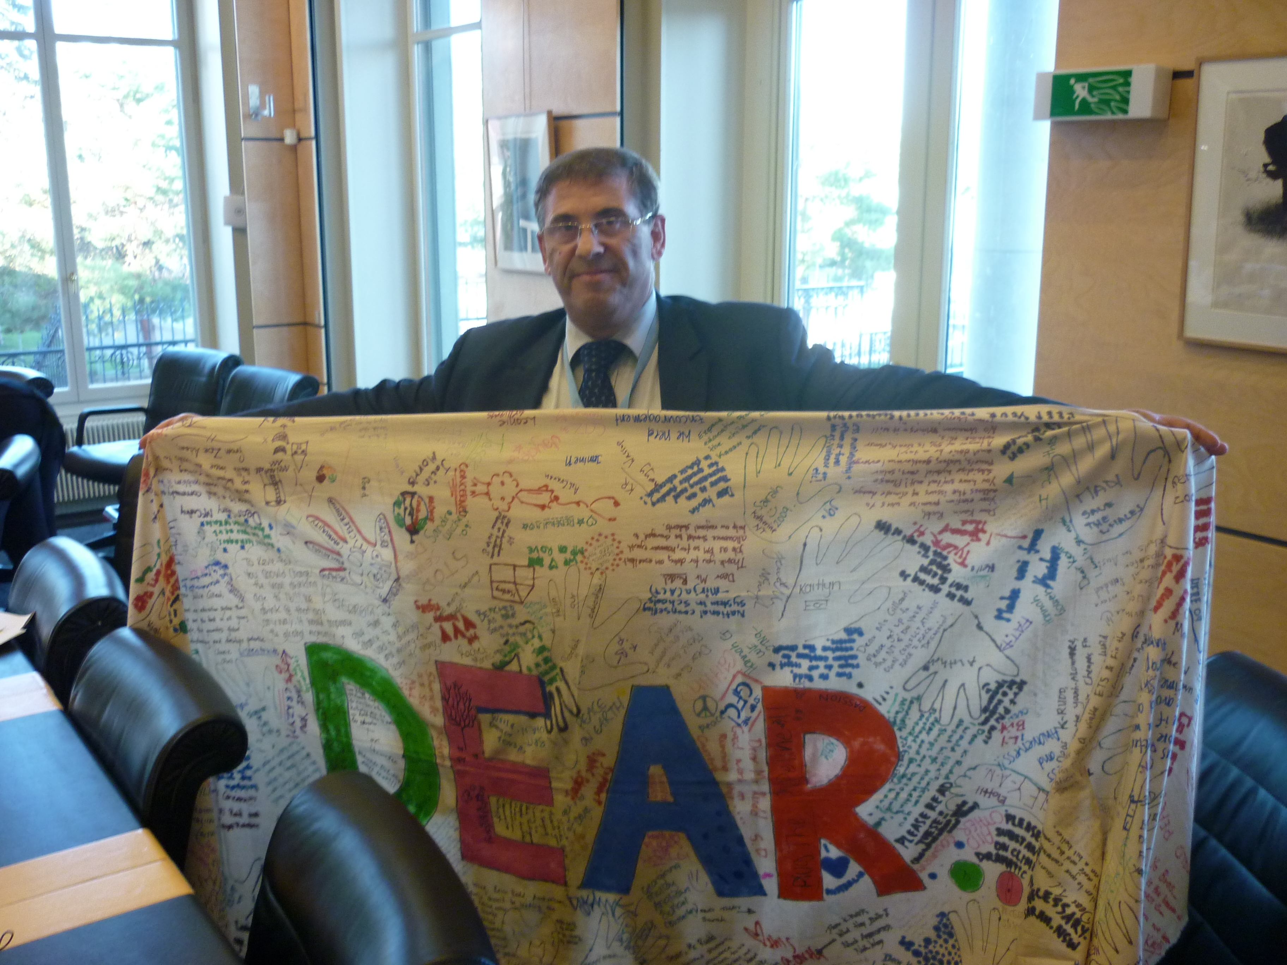

Slide 9
Follow Up - 2012
NGO Roundtables and lobbying for a National Children’s Commissioner
June Review (with a Youth Reporter from UTS)
Release of the Concluding Observations (early July)
Public event on Observations: Melbourne 12th July (University of Melbourne); Geelong (Deakin Campus) in August

Slide 10
Contact
To get involved with the Child Rights NGO Taskforce and the follow up to the Listen to Children report please contact Monash Law student Chris Varney at chris.r.varney@gmail.com

